Slide 1
Psychology… Thoughts to ponder:
Are you aware of your underwear?
Do you notice the chair you are sitting on?
If someone came over and kicked you, would you feel it?
What does school smell like?
Can you taste your own saliva?
Can you feel your own heartbeat?
Can you feel your hair grow?
What temperature is it when you don’t feel the air?
The point: Why are we aware of and how do we take in our environment?
5 senses: sight, hearing, taste, touch, smell
100 billion cells (neurons) in brain
50 billion in cerebral cortex (what separates us from other species)

Slide 2
The Nervous System
It starts with an individual nerve cell called a NEURON.

Slide 3
Neuron
A nerve cell, or a neuron, consists of many different parts.
Notes:
Preview Question 1: What are neurons, and how do they transmit information?

Slide 4
Parts of a Neuron
Cell Body: Life support center of the neuron.
Dendrites: Branching extensions at the cell body. Receive messages from other neurons.
Axon: Long single extension of a neuron, covered with myelin [MY-uh-lin] sheath to insulate and speed up messages through neurons.
Terminal Branches of axon: Branched endings of an axon that transmit messages to other neurons.

Slide 5
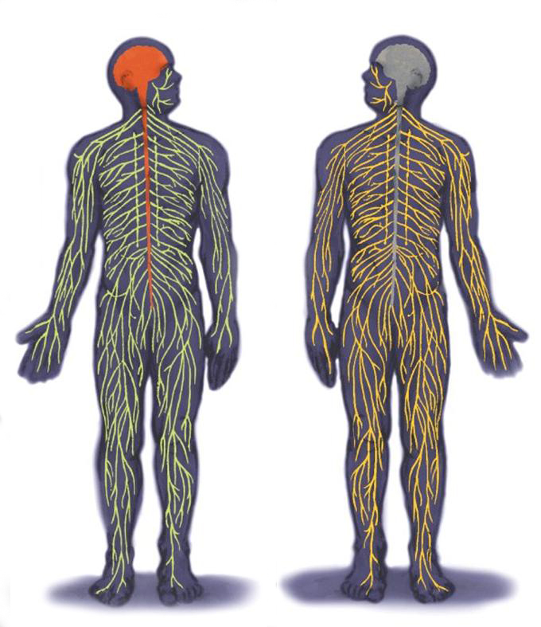
Nervous System
Central
Nervous
System
(CNS)
Peripheral
Nervous
System
(PNS)
Notes:
Preview Question 3: What are the major divisions of the nervous system, and what are their basic functions?

Slide 6
The Nervous System
Nervous System: Consists of all the nerve cells. It is the body’s speedy, electrochemical communication system.
Central Nervous System (CNS): the brain and spinal cord.
Peripheral Nervous System (PNS): the sensory and motor neurons that connect the central nervous system (CNS) to the rest of the body.

Slide 7
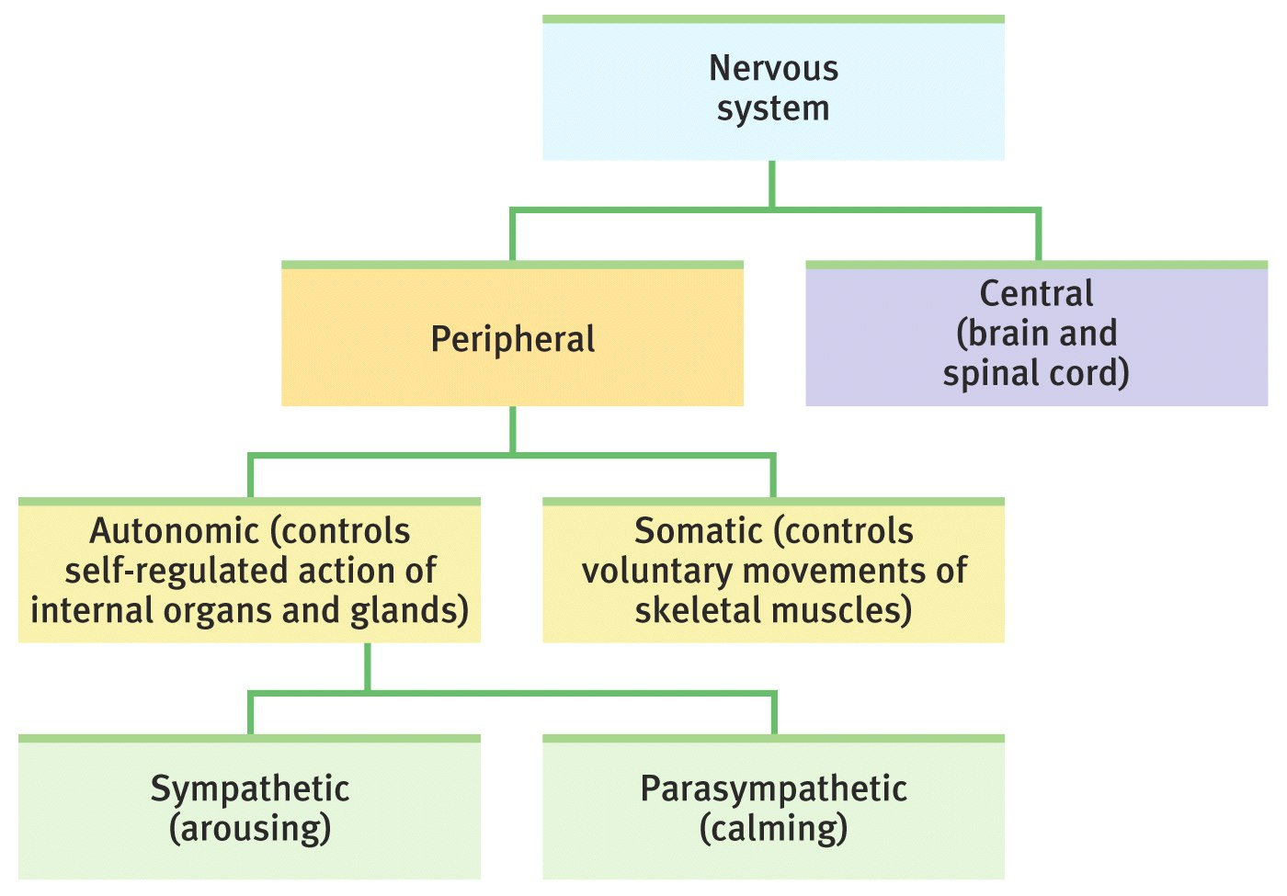
The Nervous System

Slide 8
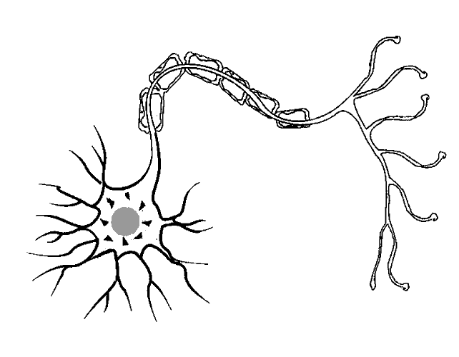
Kinds of Neurons by Function
Sensory Neurons carry incoming information from the sense receptors to the CNS.
Motor Neurons carry outgoing information from the CNS to muscles and glands.
Interneurons connect the two neurons.
Interneuron Neuron (Unipolar)
Sensory Neuron
(Bipolar)
Motor Neuron
(Multipolar)

Slide 9
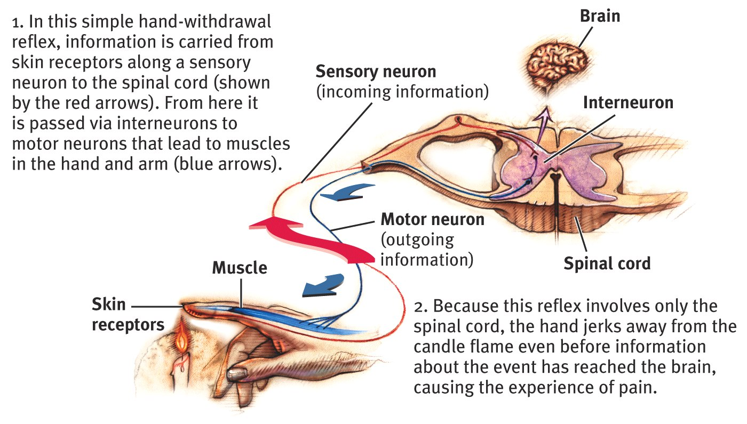
Central Nervous System
The Spinal Cord and Reflexes
Simple Reflex

Slide 10
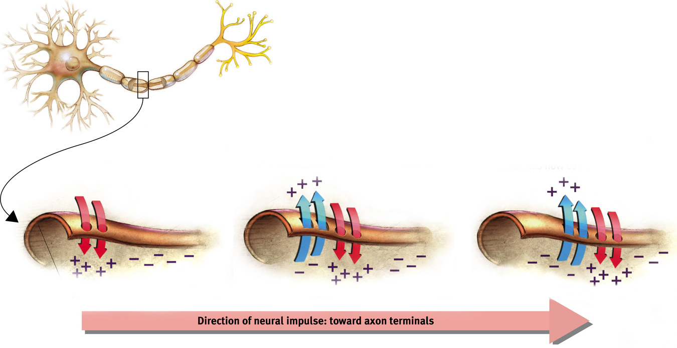
Action Potential
A neural impulse. A brief electrical charge that travels down an axon and is generated by the movement of positively charged atoms in and out of channels in the axon’s membrane.
Potential = Voltage (Action potential refers to the impulse during action/Resting Potential refers to the impulse during rest)

Slide 11
Synapse
Synapse: a junction between the axon tip of the sending neuron and the dendrite or cell body of the receiving neuron. This tiny gap is called the synaptic gap or cleft.

Slide 12
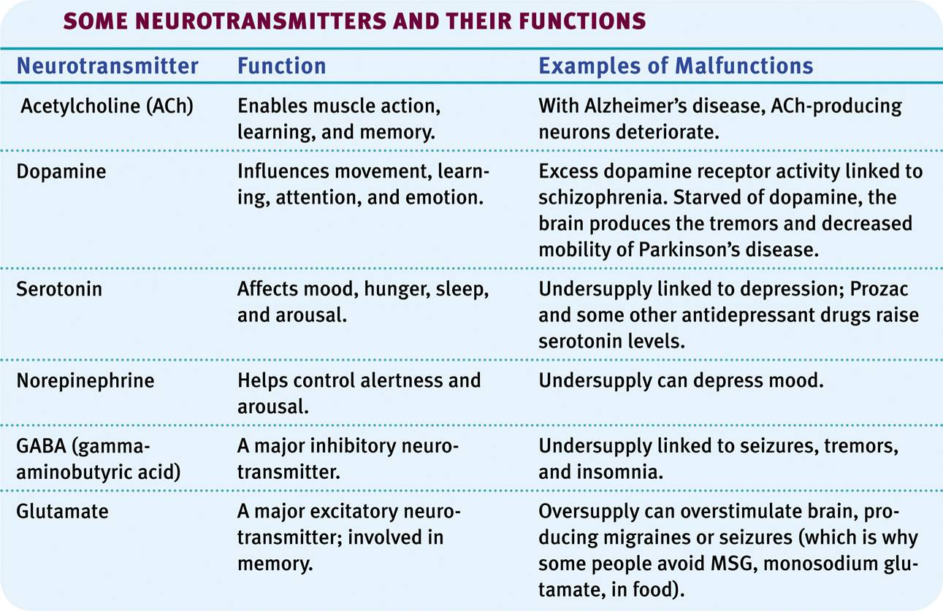
Neurotransmitters

Slide 13
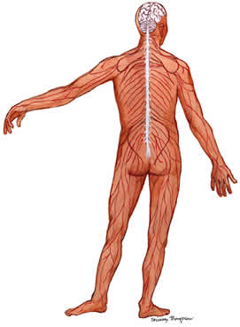
Peripheral Nervous System
All nerves that are not encased in bone.
Everything but the brain and spinal cord.
Is divided into two categories….somatic and autonomic.

Slide 14
Peripheral Nervous System
Somatic Nervous System: The division of the peripheral nervous system that controls the body’s skeletal muscles.
Autonomic Nervous System: Part of the PNS that controls the glands and internal organs.

Slide 15
Autonomic Nervous System
Controls the automatic functions of the body.
Divided into two categories…the sympathetic and the parasympathetic

Slide 16
Autonomic Nervous System (ANS)
Sympathetic Nervous System: arouses the body, mobilizing its energy in stressful situations, “fight or flight”
Parasympathetic Nervous System: calms the body, conserving its energy, rest & digestion.

Slide 17
Sympathetic Nervous System
Fight or Flight Response.
Automatically accelerates heart rate, breathing, dilates pupils, slows down digestion.

Slide 18
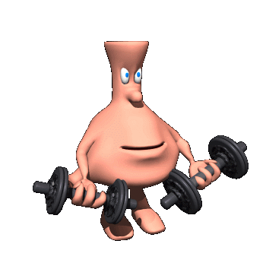
Parasympathetic Nervous System
Automatically slows the body down after a stressful event.
Heart rate and breathing slow down, pupils constrict and digestion speeds up.

Slide 19
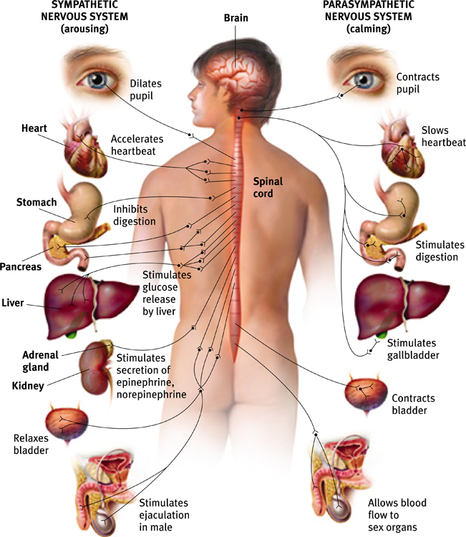
Autonomic Nervous System (ANS)
Sympathetic NS “Arouses”
(fight-or-flight)
Parasympathetic NS “Calms”
(rest and digest)

Slide 20
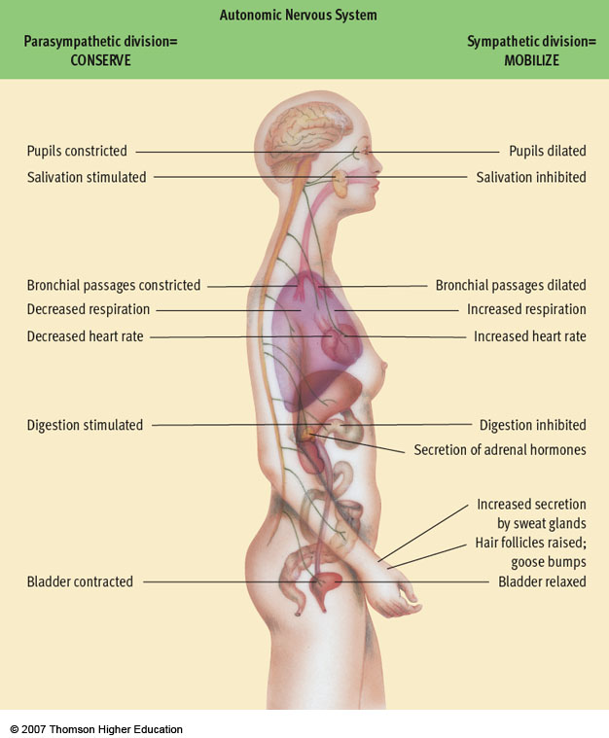
Fig. 3-8, p. 83
Notes:
Figure 3.8: The autonomic nervous system (ANS).
The ANS is composed of the nerves that connect to the heart, blood vessels, smooth muscles, and glands. The ANS is divided into the sympathetic division, which mobilizes bodily resources in times of need, and the parasympathetic division, which conserves bodily resources. Some of the key functions controlled by each division of the ANS are summarized in the diagram.

Slide 21
Emotions and the Autonomic Nervous System
During an emotional experience, our autonomic nervous system mobilizes energy in the body that arouses us.
Notes:
Preview Question 2: What is the link between emotional arousal and the autonomic nervous system?

Slide 22
Central Nervous System
The Spinal Cord and Reflexes
Simple Reflex

Slide 23
The Nervous System

Slide 24
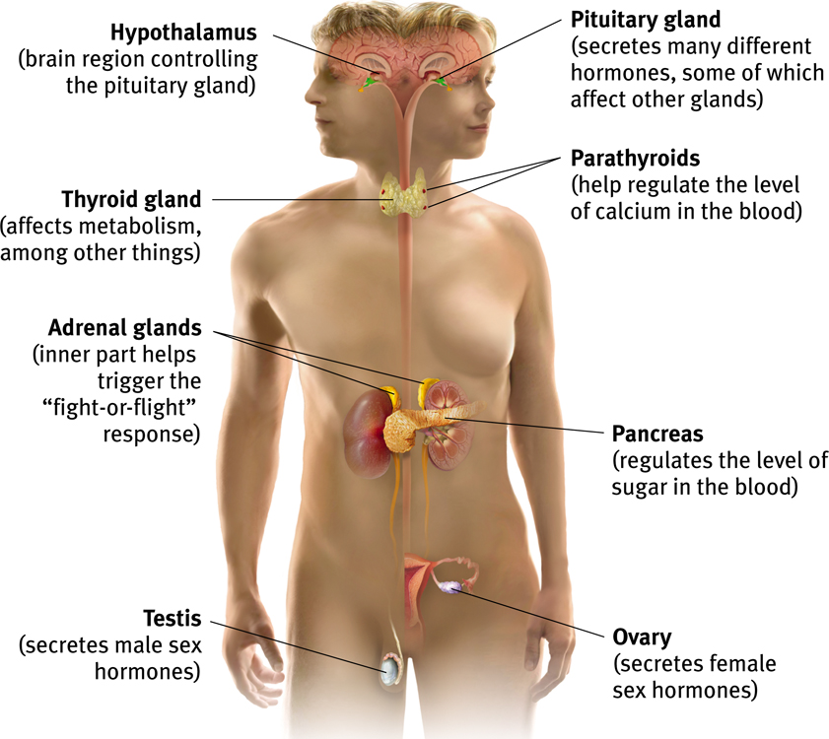
The Endocrine System
The Endocrine System is the body’s “slow” chemical communication system. Communication is carried out by hormones synthesized by a set of glands.
Notes:
Preview Question 4: How does the endocrine system-the body’s slower information system-transmit its messages?

Slide 25
Nervous System vs. Endocrine System
Both:
Regulate conditions in body
Use chemicals for communication
Nervous System
Chemicals of Nervous System = neurotransmitters
Nervous system secretes neurotransmitters b/w nerve cells
Signals sent in fractions of a second
Endocrine System
Chemicals of Endocrine = hormones
Endocrine system secretes hormones into blood stream
Chemicals can take many seconds to begin working, effects can last longer (hours, days)
Notes:
blood brain barrier : separation of circulating blood from cerebrospinal fluid (CSF). Endothelial cells (think of as thin skin on the inside of your body) restrict the diffusion of molecules by their size (too big can’t get through) and by their ability to dissolve in water (hydrophobic, hydrophillic)
Cells of the barrier actively transport metabolic products such as glucose across the barrier with specific proteins.

Slide 26
Studying the Living Human Brain
Animal studies and clinical observations are useful, but often, such as when we need to diagnose or treat illness, we want to know what is happening inside the brain of a living human.
For this we have:
EEG: Electroencephalogram
MRI: Magnetic resonance imaging
PET Scan: Positron emission tomography
CT Scan (or CAT Scan): Computerized Tomography
Notes:
CT (computerized tomography) uses a sophisticated X ray machine combined with a computer to create a detailed picture of the body’s tissues and structure. Usually a special dye called a contrast material will be injected prior to the scan. This makes it easier to see abnormal tissue due to specific absorption rates.

Slide 27
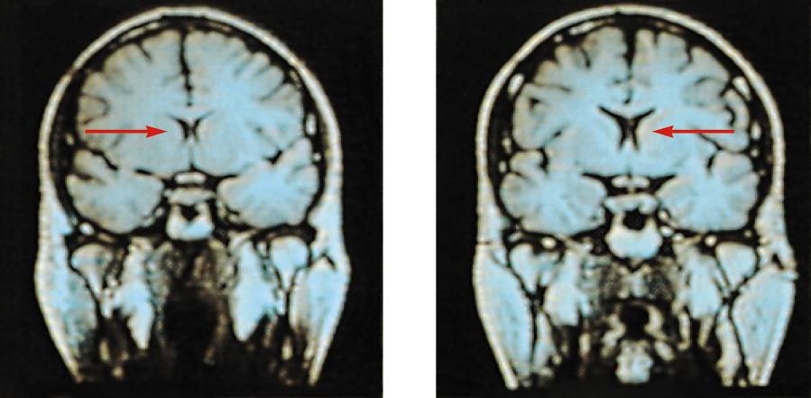
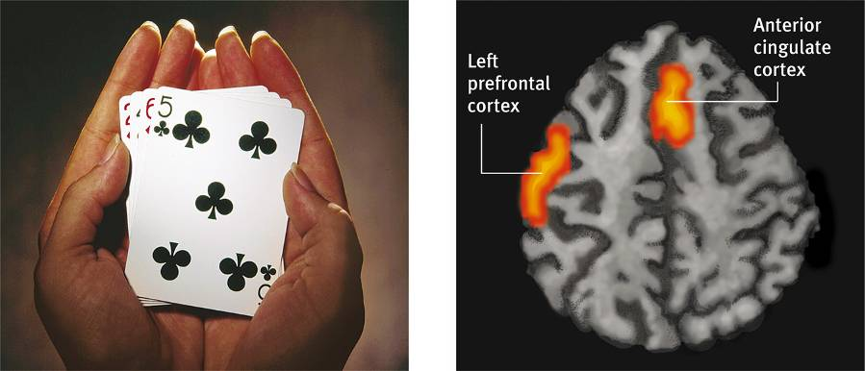
MRI: Magnetic Resonance Imaging
MRI uses magnetic fields and radio waves to produce computer-generated images that distinguish among different types of brain tissue.
Top images show ventricular enlargement in a schizophrenic patient.
Bottom image shows brain regions when a participants lies.
fMRI reveals a brain’s function as well as its structure by monitoring blood flow.
Both photos from Daniel Weinberger, M.D., CBDB, NIMH
James Salzano/ Salzano Photo
Lucy Reading/ Lucy Illustrations

Slide 28
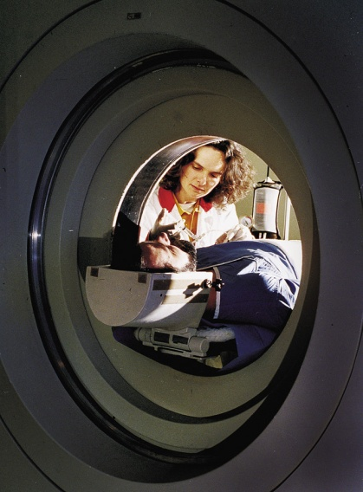
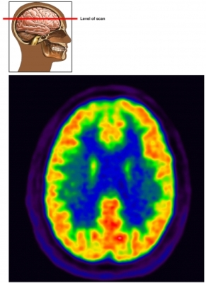
PET Scan: Positron Emission Tomography
PET Scan is a visual display of brain activity
Detects gamma rays emitted by a radioactive form of glucose while the brain performs a given task.
Courtesy of National Brookhaven National Laboratories

Slide 29
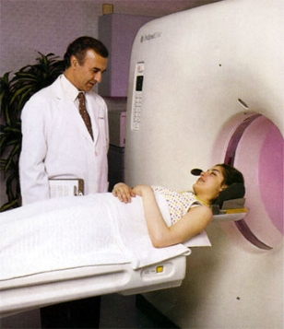
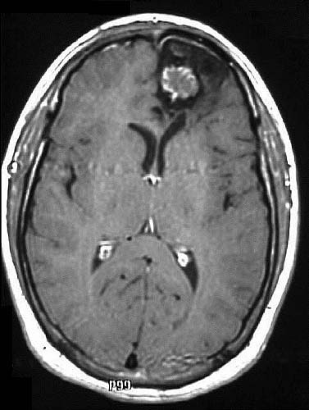
CT Scan: Computerized Tomography
X-ray rotates around head.
May be done with or without contrasting dye.
Images taken from different angles are assembled into 3-D image
CT scan produces much more detailed image than x-ray of bone and soft tissue
Notes:
A CT or CAT scan (computed tomography) is a much more sensitive imaging technique than x-ray, allowing high definition not only of the bony structures, but of the soft tissues. Clear images of organs such as the brain, muscles, joint structures, veins and arteries, as well as anomalies like tumors and hemorrhages may be obtained with or without the injection of contrasting dye.

Slide 30
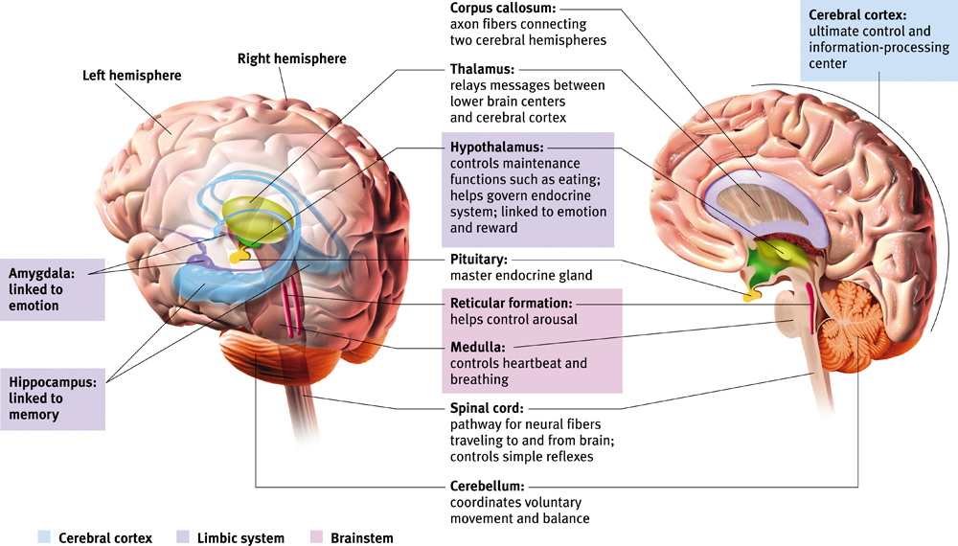
The Cerebral Cortex
The intricate fabric of interconnected neural cells that covers the cerebral hemispheres. It is the body’s ultimate control and information processing center.

Slide 31
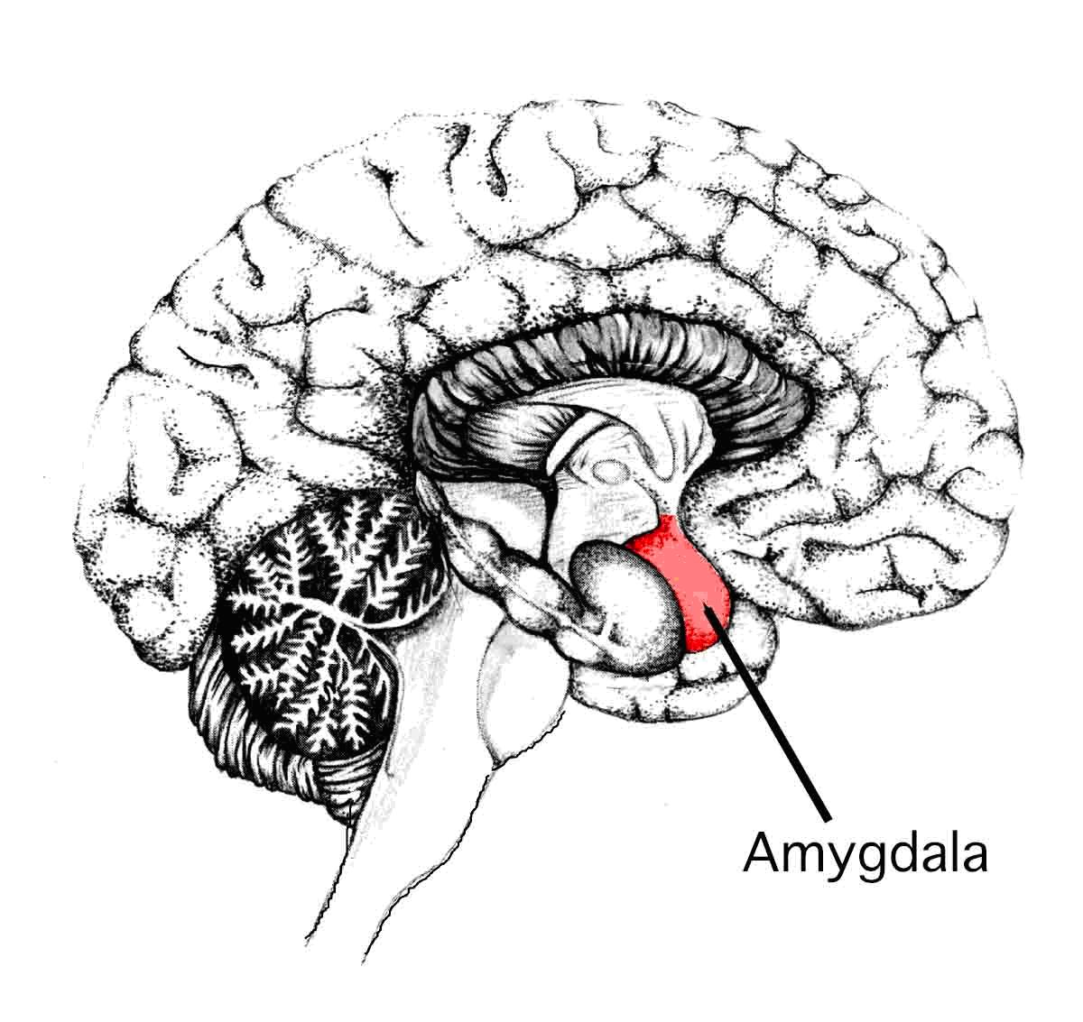
Amygdala
The Amygdala [ah-MIG-dah-la] consists of two lima bean-sized neural clusters linked to the emotions of fear and anger.

Slide 32
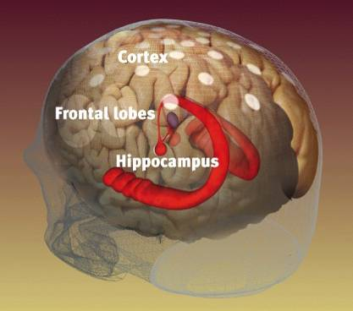
Hippocampus
Hippocampus – a neural center in the limbic
system that processes explicit memories.
Weidenfield & Nicolson archives

Slide 33
Storing Implicit & Explicit Memories
Explicit Memory refers to facts and experiences that one can consciously know and declare. Implicit memory involves learning an action while the individual does not know or declare what she knows.

Slide 34
Anterograde Amnesia
After losing his hippocampus in surgery, patient Henry M. (HM) remembered everything before the operation but cannot make new memories. We call this anterograde amnesia.
Anterograde
Amnesia
(HM)
Memory Intact
No New Memories
Surgery

Slide 35
Implicit Memory
HM is unable to make new memories that are
declarative (explicit), but he can form new
memories that are procedural (implicit).
A
B
C
HM learned the Tower of Hanoi (game) after his surgery. Each time he plays it, he is unable to remember the fact that he has already played the game.

Slide 36
Hypothalamus
Hypothalamus lies below (hypo) the thalamus.
Directs maintenance activities like eating, drinking, body temperature, and control of emotions.
It stimulates or inhibits pituitary gland → other endocrine glands

Slide 37
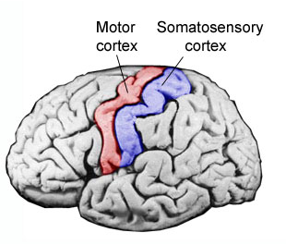
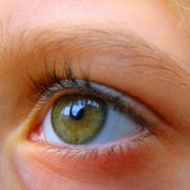
Thalamus
The Thalamus [THAL-uh-muss] is the brain’s sensory switchboard, located on top of the brainstem.
It directs messages to the sensory areas in the cortex and transmits replies to the cerebellum and medulla.
1.
2.
3.
4.
To cerebellum
To medulla

Slide 38
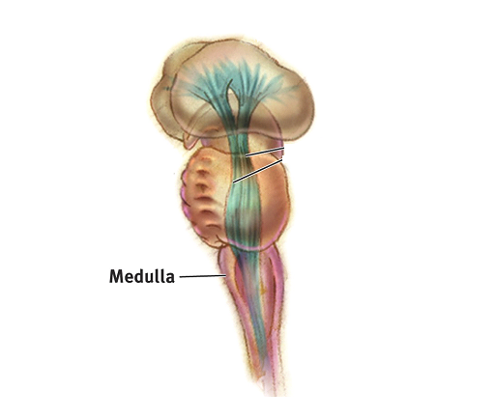
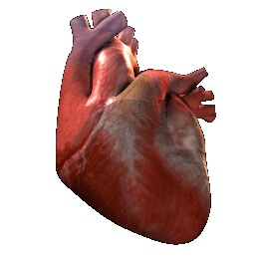
Medulla
The Medulla [muh-DUL-uh] is the base of the brainstem that controls heartbeat and breathing.

Slide 39
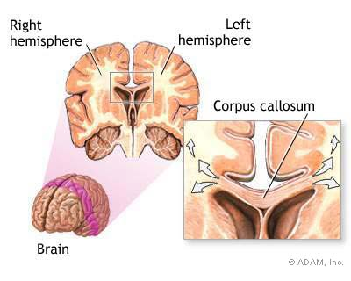

Slide 40
Split Brain Patients
With the corpus callosum severed, objects (apple) presented in the right visual field can be named. Objects (pencil) in the left visual field cannot.

Slide 41
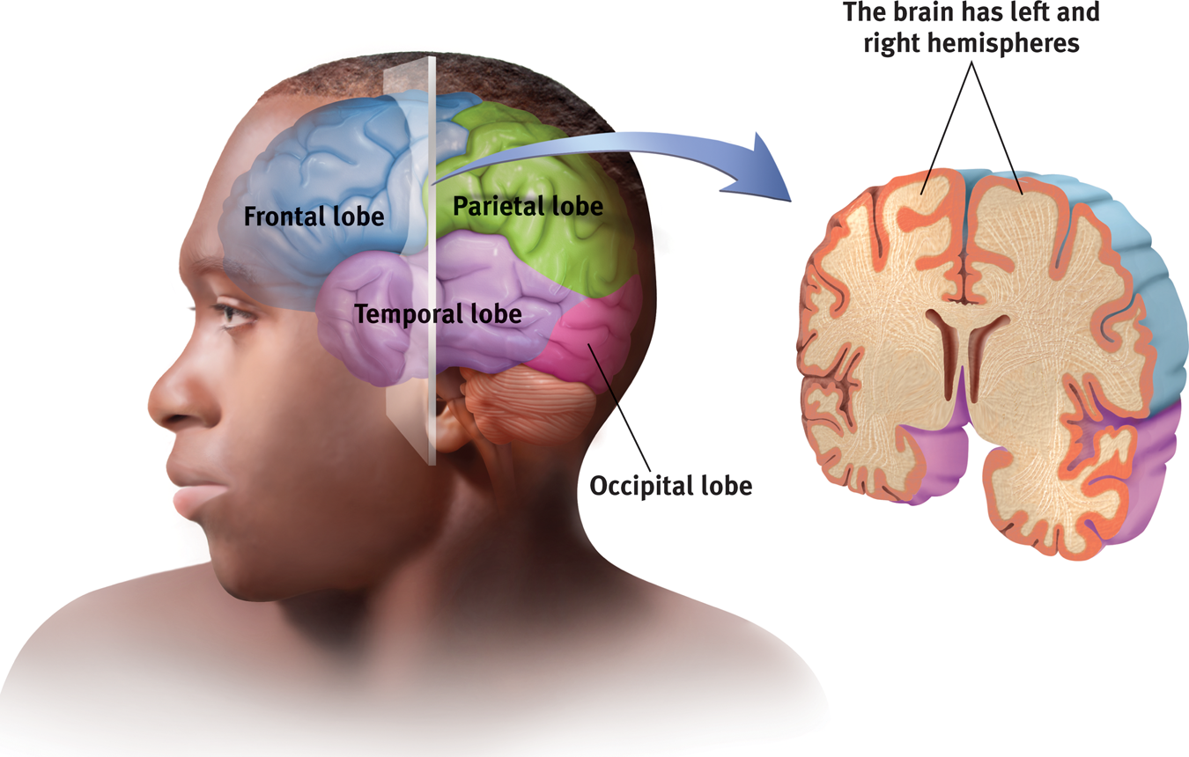
Structure of the Cortex
Each brain hemisphere is divided into four lobes
Frontal Lobe: Speaking, muscle movements, making plans and judgments.
Notes:
Preview Question 7: What are the four lobes of the cerebral cortex, and where are they located?

Slide 42
Functions of the Cortex
The Motor Cortex is the area at the rear of the frontal lobes that control voluntary movements.
The Sensory Cortex (parietal cortex) receives information from skin surface and sense organs.
Notes:
Preview Question 8: What are the functions of the cerebral cortex?

Slide 43
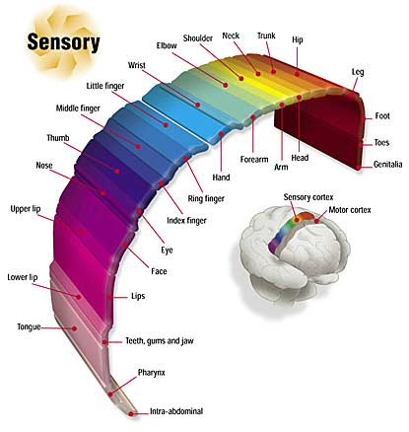
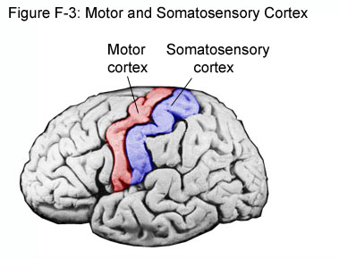
Notes:
Preview Question 8: What are the functions of the cerebral cortex?

Slide 44
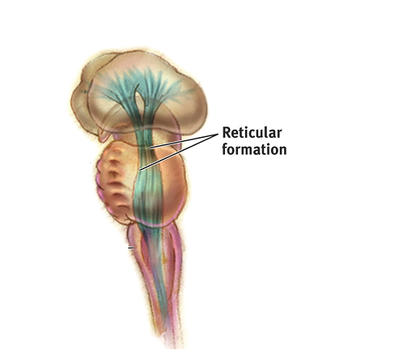
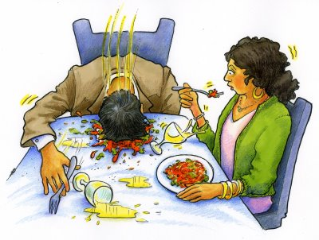
Reticular Formation
Reticular Formation is a nerve network in the brainstem that plays an important role in controlling arousal.
Damage to this causes a disorder called narcolepsy in which a person falls asleep suddenly during the daytime and cannot resist the sleep.

Slide 45
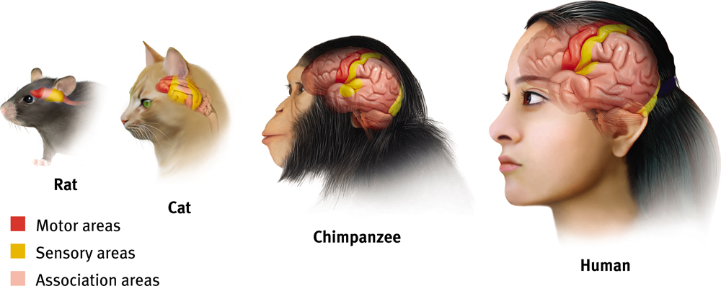
Association Areas
More intelligent animals have increased “uncommitted” or association areas of the cortex. These areas are responsible for integrating and acting on information received and processed by sensory areas.

Slide 46
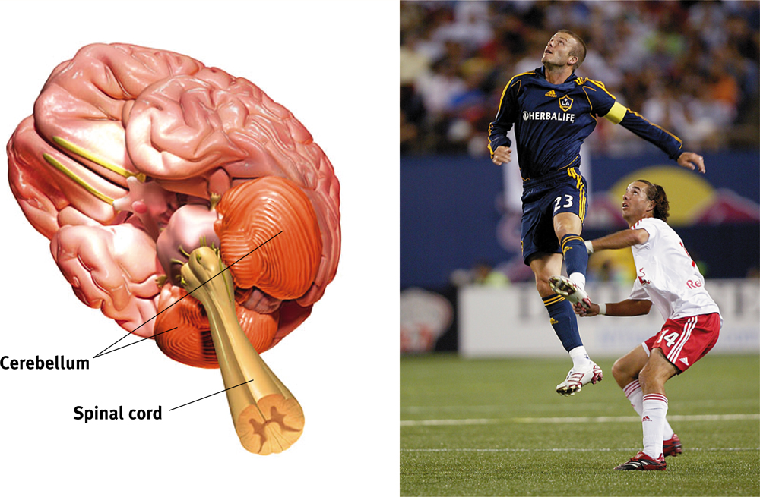
Cerebellum
The “little brain” attached to the rear of the brainstem.
It helps coordinate voluntary movements and balance.
Implicit (procedural) memory.

Slide 47
