Slide 1
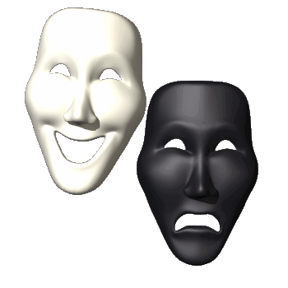
Personality
A person’s pattern of thinking, feeling and acting.

Slide 2
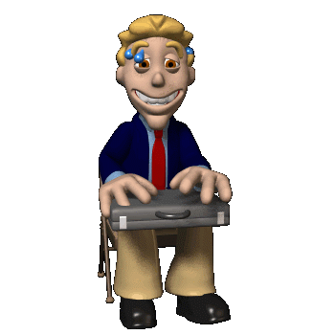
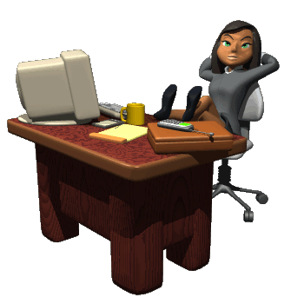
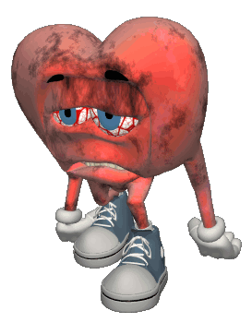
Types of Personalities
Type A
Type B
Feel time pressure.
Easily angered.
Competitive and ambitious.
Work hard and play hard.
More prone to heart disease than rest of population.
Relaxed and easygoing.
But some people fit in neither type.

Slide 3
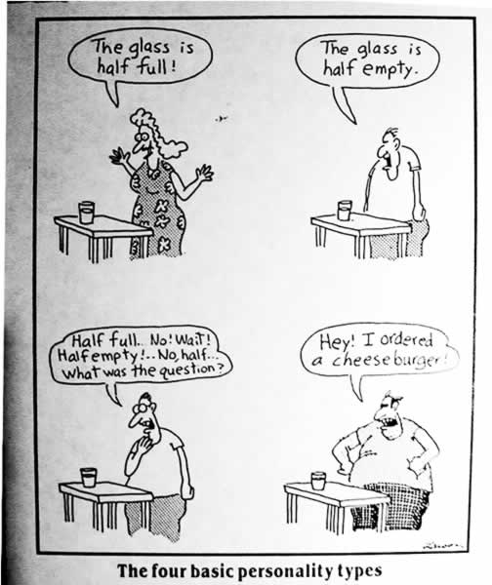

Slide 4
Our Personality
Conscious- things we are aware of.
Preconscious- things we can be aware of if we think of them.
Unconscious- deep hidden reservoir that holds the true “us”. All of our desires and fears.

Slide 5
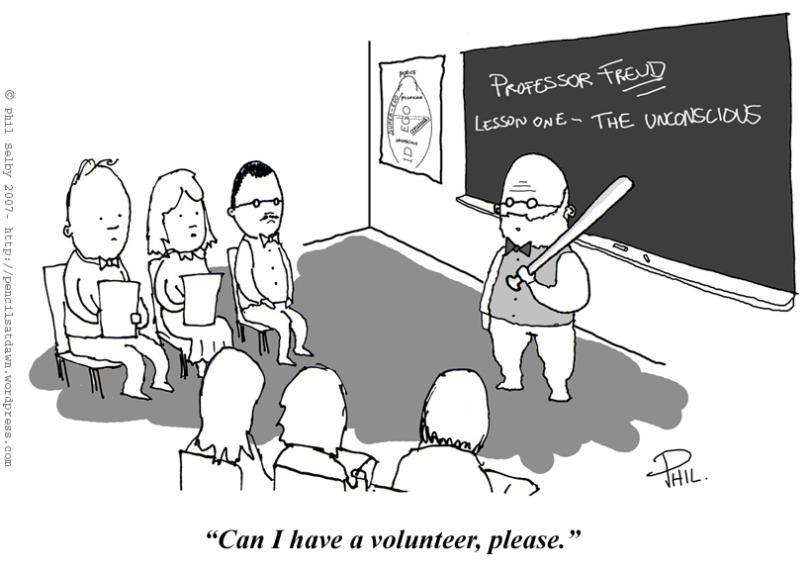

Slide 6
Freud’s Concept of Personality (Psyche)
Ego
Superego
Id

Slide 7
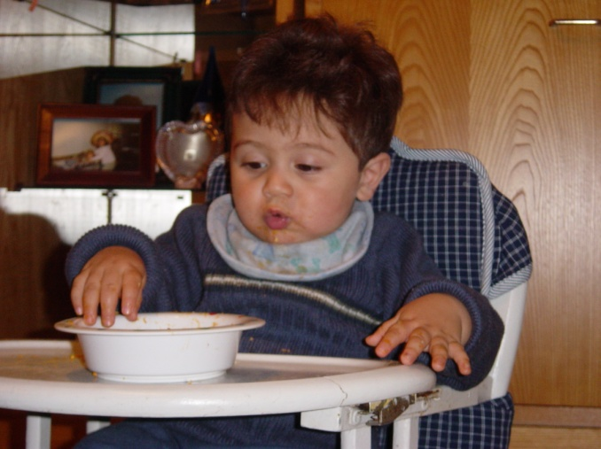
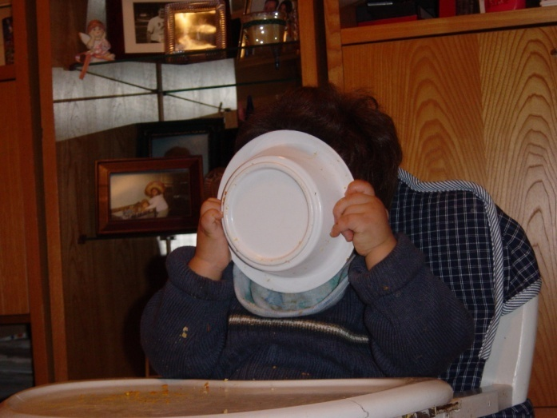
Id
Exists entirely in the unconscious (so we are never aware of it).
Our hidden true animalistic wants and desires.
Works on the Pleasure Principle
Avoid Pain and receive Instant Gratification.

Slide 8
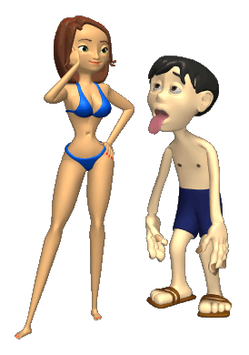
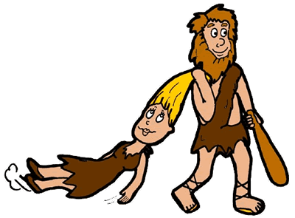
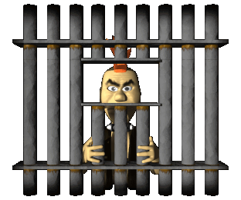
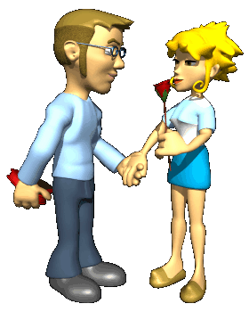
Ego
If you want to be with someone. Your id says just take them, but your ego does not want to end up in jail. So you ask her out and just mac it hard.
Develops after the Id
Works on the Reality Principle
Negotiates between the Id and the environment.
In our conscious and unconscious minds.
It is what everyone sees as our personality.

Slide 9
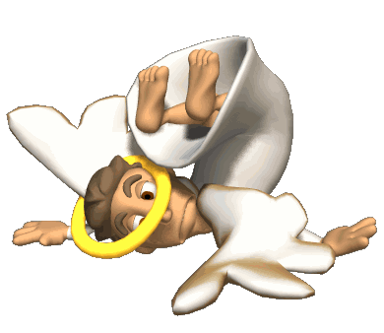
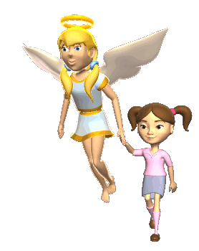
Superego
Develops last at about the age of 5
It is our conscience (what we think the difference is between right and wrong)
The Ego often mediates between the superego and id.

Slide 10
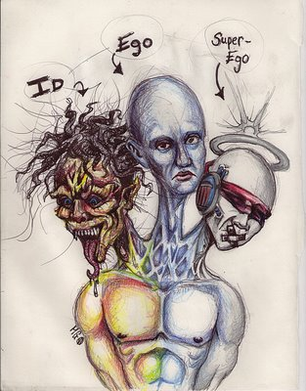

Slide 11
Defense Mechanisms
The ego has a pretty important job…and that is to protect you from threatening thoughts in our unconscious.
One way it protects us is through defense mechanisms.
You are usually unaware that they are even occurring.

Slide 12
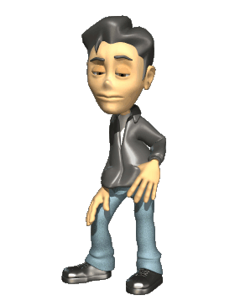
Scenario
Quarterback of the high school football team, Brandon, is dating Jasmine.
Jasmine dumps Brandon and starts dating Drew, president of the chess club.
Brandon
Jasmine
Drew

Slide 13
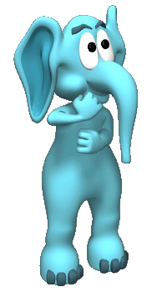
Repression
Pushing thoughts into our unconscious.
When asked about Jasmine, Brandon may say “Who?, I have not thought about her for awhile.”
Why don’t we remember our Oedipus and Electra complexes?

Slide 14
Denial
Not accepting the ego-threatening truth.
Brandon may act like he is still together with Jasmine. He may hang out by her locker and plan dates with her.

Slide 15
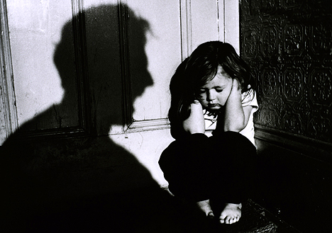
Displacement
Redirecting one’s feelings toward another person or object.
Often displaced on less threatening things.
Brandon may take his anger on another kid by bullying.

Slide 16
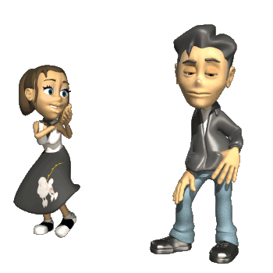
Projection
Believing that the feelings one has toward someone else are actually held by the other person and directed at oneself.
Brandon insists that Jasmine still cares for him.

Slide 17
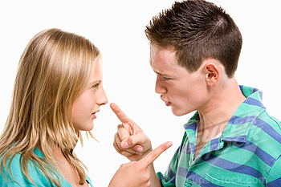
Reaction Formation
Expressing the opposite of how one truly feels.
Cootie stage in Freud’s Latent Development.
Brandon claims he hates Jasmine.

Slide 18
Regression
Returning to an earlier, comforting form of behavior.
Brandon begins to sleep with his favorite childhood stuffed animal, Muffy.

Slide 19
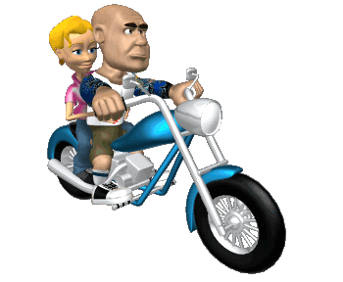
Rationalization
Coming up with a beneficial result of an undesirable outcome.
Brandon thinks he will find a better girlfriend. “Jasmine was not all that anyway!”
I really did want to go to ……..anyway, it was too ……

Slide 20
Intellectualization
Undertaking an academic, unemotional study of a topic.
Brandon starts doing a research paper on failed teenage romances.

Slide 21
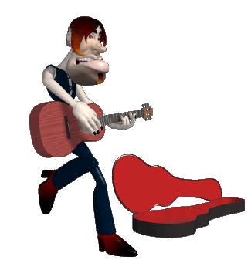
Sublimation
Channeling one’s frustration toward a different goal.
Sometimes a healthy defense mechanism.
Brandon starts to learn how to play the guitar and writing songs (or maybe starts to body build).

Slide 22
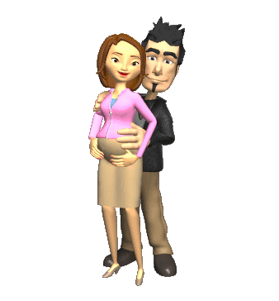
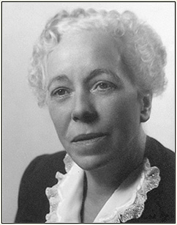
Criticisms of Freud
He really only studied wealthy woman in Austria.
His results are not empirically verifiable (really hard to test).
No predictive power.
Karen Horney said he was sexist with the “penis envy” and there is an actual “womb envy”.

Slide 23
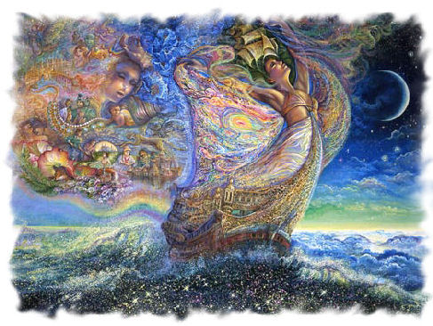
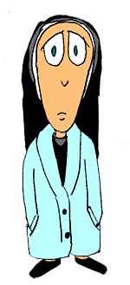
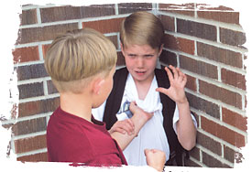
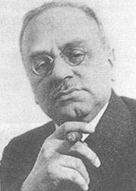
Neo-Freudians Psychodynamic Theories
Eric Erickson
Carl Jung and his concept of the “personal” and “collective” unconscious.
Alfred Adler and his ideas of superiority and inferiority.
Adler also talked about birth order and how it played a part in personality.

