Slide 1
Psychological Disorders
Ms. Blackhurst
“Abnormal Psychology”

Slide 2
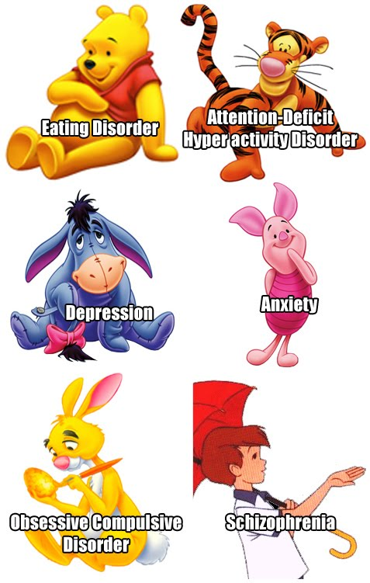
Disclaimer:
Don’t, in the course of this chapter, contract “Medical Student’s Disease.”
The belief that, as you study each component of abnormal psychology, that you or someone you know may have the disease.
It may be true… most of the time, it isn’t.

Slide 3
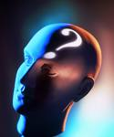
Abnormal Psychology A.K.A. Psychological Disorders
A “harmful dysfunction” in which behavior is judged to be atypical, disturbing, maladaptive and unjustifiable.

Slide 4
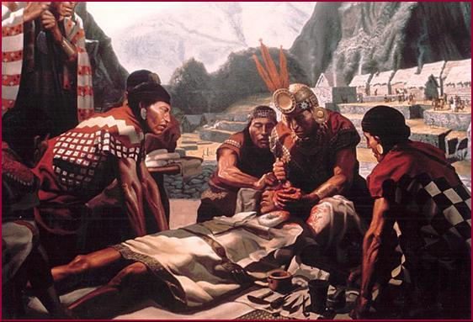
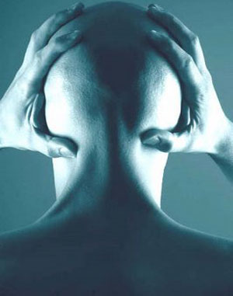
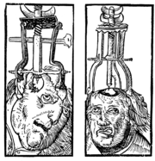
Early Theories
Abnormal behavior was evil spirits trying to get out.
Trephining was often used.

Slide 5
Perspectives and Disorders
Psychological School/Perspective | Cause of the Disorder
Psychoanalytic/Psychodynamic | Internal, unconscious drives
Humanistic | Failure to strive to one’s potential or being out of touch with one’s feelings.
Behavioral | Reinforcement history, the environment.
Cognitive | Irrational, dysfunctional thoughts or ways of thinking.
Sociocultural | Dysfunctional Society
Biomedical/Neuroscience | Organic problems, biochemical imbalances, genetic predispositions.

Slide 6
Normal v. Abnormal
Criteria
Deviation from normality (what most people do)
Adjustment – Do not adjust physically, emotionally, or socially as others do
Psychological health
Facts
Hard to define
No clear standard

Slide 7
Normal v. Abnormal
Context of Behavior:
Some behaviors are clearly bizarre in a given situation
Watering your lawn in a rainstorm
Persistence of Behavior:
We all have crazy moments.
Dancing all the time for no reason at all.
Social Deviance:
Radically violating norms daily – visuals hallucinations
Subjective Distress:
Suffering causes daily activities to be a problem
Ex: not riding on an elevator or taking the stairs

Slide 8
Classifying Mental Illness
DSM-IV
Diagnostic and Statistical Manual of Mental Disorders
Sets forth specific diagnostic criteria for disorders and helps differentiate between disorders
Labels a person – can have negative influence on person’s future
Impacts how others regard/view person

Slide 9
DSM IV
Diagnostic Statistical Manual of Mental Disorders: the big book of disorders.
DSM will classify disorders and describe the symptoms.
DSM will NOT explain the causes or possible cures.

Slide 11
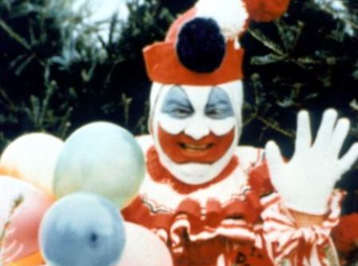
Two Major Classifications in the DSM
Neurotic Disorders
Psychotic Disorders
Distressing but one can still function in society and act rationally.
Person loses contact with reality, experiences distorted perceptions.
John Wayne Gacy

Slide 12
DSM-IV Axis
Axis I
clinical disorders and developmental and learning disorders.
Axis 2
personality disorders or mental retardation, includes autism
Axis 3
medical and/or physical conditions or disorders
Axis 4
Psychosocial & Environmental Problems
Axis 5
Overall psychological, social, and occupational functioning (scale from 1 – 100)

Slide 13
Insanity
Legal term
Many people with Psych disorders are SANE
Unaware of actions at the time of the crime
“Not guilty by reason of insanity” – studies show, held as long in mental institution as if found guilty

Slide 14
Major Disorders – Axis I – DSM-IV
DSM-IV classifies symptoms into categories
Schizophrenia
Mood Disorders
Anxiety Disorders
Somatoform Disorders
Dissociative Disorders
Eating Disorders
Sleep Disorders

