Slide 1
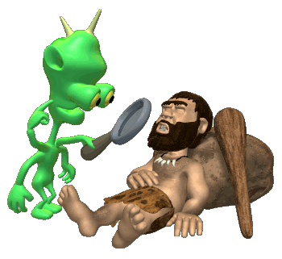
Research Methods
It is actually way more exciting than it sounds!!!!

Slide 2

Why do we have to learn this stuff?
Psychology is first and foremost a science.
Thus it is based in research.
Before we delve into how to do research, you should be aware of three hurdles that tend to skew our logic.

Slide 3

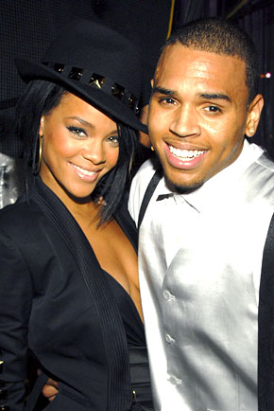
Hindsight Bias
The tendency to believe, after learning the outcome, that you knew it all along.
Monday Morning Quarterbacking!!!
After the Chris Brown/Rihanna incident… many people said she knew Chris Brown was a violent kid!!! Did she really?

Slide 4
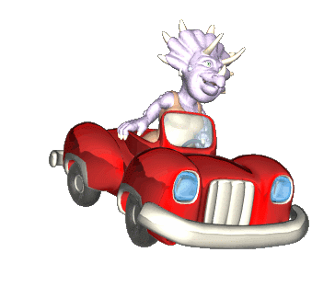
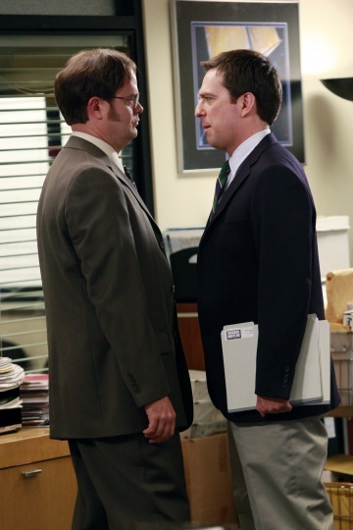
Overconfidence
We tend to think we know more than we do.
82% of U.S. drivers consider themselves to be in the top 30% of their group in terms of safety.
81% of new business owners felt they had an excellent chance of their businesses succeeding. When asked about the success of their peers, the answer was only 39%. (Now that's overconfidence!!!)

Slide 5




Let’s check your horoscopes for today…
I’ll pass out your horoscope for today.
You read through it and tell me how true you think it is.
Let’s discuss!

Slide 6
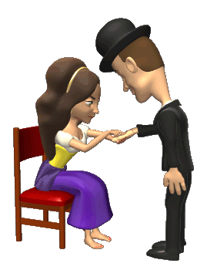
The Barnum Effect
It is the tendency for people to accept very general or vague characterizations of themselves and take them to be accurate.

Slide 7
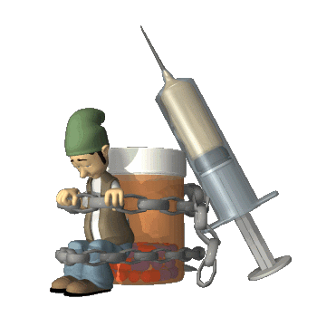
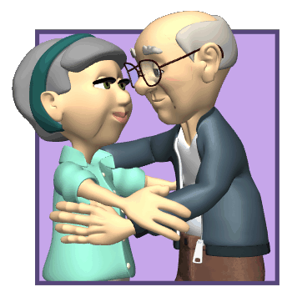
Applied V. Basic Research
Applied Research has clear, practical applications.
YOU CAN USE IT!!!
Basic Research explores questions that you may be curious about, but not intended to be immediately used.
Studying how kissing changes when you get older is interesting…but that’s about it.
Research on therapies for drug addicts has a clear purpose.

Slide 8

Terminology

Slide 9
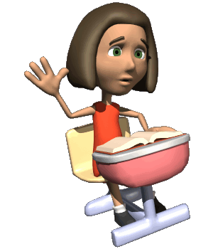

Hypothesis
Expresses a relationship between two variables.
A variable is anything that can vary among participants in a study.
Participating in class leads to better grades than not participating.

Slide 10
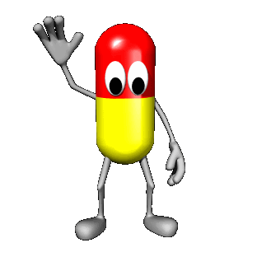
Independent Variable
Whatever is being manipulated in the experiment.
Hopefully the independent variable brings about change.
If there is a drug in an experiment, the drug is almost always the independent variable.

Slide 11

Dependent Variable
Whatever is being measured in the experiment.
It is dependent on the independent variable.
The dependent variable would be the effect of the drug.

