Slide 1
Defining Sensation and Perception
Sensation
The detection of physical energy emitted or reflected by physical objects.
It occurs when energy in the external environment or the body stimulates receptors in the sense organs.
Perception
The process by which the brain organizes and interprets sensory information.

Slide 2
Sensory Adaptation
Decreased responsiveness to stimuli due to constant stimulation.
Do you feel your underwear all day?

Slide 3
Cocktail-party phenomenon
The cocktail party effect describes the ability to focus one's listening attention on a single talker among a mixture of conversations and background noises, ignoring other conversations.
Form of selective attention.

Slide 4
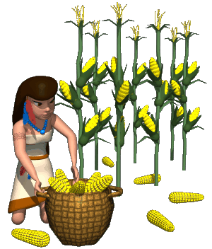
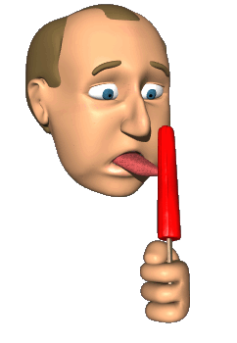
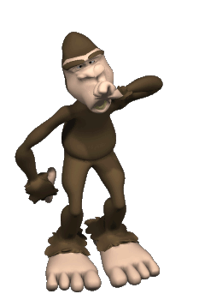
Energy v. Chemical senses
Energy Senses
Chemical Senses

Slide 5
Vision
Our most dominating sense.
Visual Capture

Slide 6
Vision: Agenda
What we see.
An eye on the world.
Why the visual system is not a camera.
How we see colors.
Constructing the visual world.

Slide 7
What We See
Hue
Visual experience specified by color names and related to the wavelength of light.
Brightness
Lightness and luminance; the visual experience related to the amount of light emitted from or reflected by an object.
Saturation
Vividness or purity of color; the visual experience related to the complexity of light waves.

Slide 8
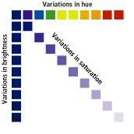
What We See
Hue
Brightness
Saturation

Slide 9
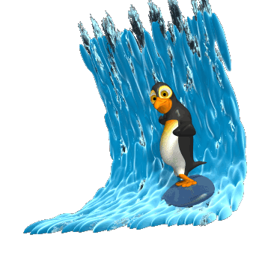
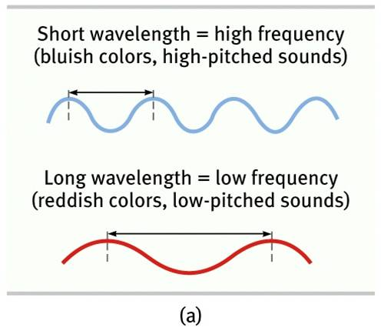
Phase One: Gathering Light
The height of a wave gives us it’s intensity (brightness).
The length of the wave gives us it’s hue (color).
ROY G BIV
The longer the wave the more red.
The shorter the wavelength the more violet.

Slide 10
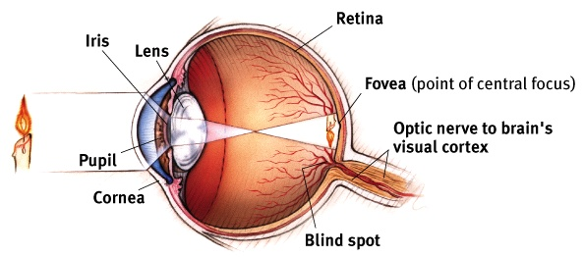
Phase Two: Getting the light in the eye

Slide 11
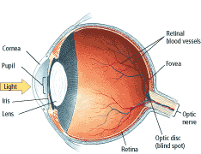
An Eye on the World
Cornea
Protects eye and bends light toward lens.
Lens
Focuses on objects by changing shape.
Iris
Controls amount of light that gets into eye.
Pupil
Widens or dilates to let in more light.

Slide 12
An Eye on the World
Retina
Neural tissue lining the back of the eyeball’s interior, which contains the receptors for vision.
Rods
Visual receptors that respond to dim light.
Cones
Visual receptors involved in color vision. Most humans have 3 types of cones.

Slide 13
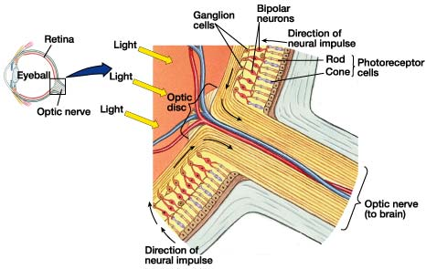
The Structures of the Retina

Slide 14
Match the following
Cornea
D
Pupil
A
Iris
B
Lens
C
Retina
E
Adjustable opening in the center of the eye
Ring of muscle, color portion of the eye around pupil- controls size of pupil opening
Transparent- behind pupil, changes shape to focus images on retina
Protects eye, bends light to provide focus
Eyes light sensitive inner surface- rods, cones, neurons that process visual info.

Slide 15
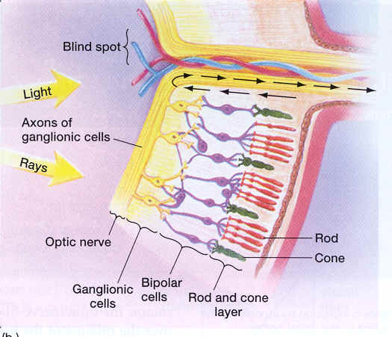
Phase Three: Transduction

Slide 16
Transduction Continued
Order is Rods/Cones to Bipolar to Ganglion to Optic Nerve.
Sends info to thalamus- area called lateral geniculate nucleus (LGN).
Then sent to cerebral cortexes.
Where the optic nerves cross is called the optic chiasm.

Slide 17
Transduction
Transforming signals into neural impulses.
Information goes from the senses to the thalamus , then to the various areas in the brain.
Remember Ethan in Sky High. He changes his body to slime. Solid form to liquid form. Change from one form of energy to another. Click the picture to watch power placement.

