Slide 1
Factors that Influence Perception
The Object of Perception:
some things in our environment tend to attract attention
Backgrounds and Surroundings
our surroundings at the moment of perception will affect our perceptions
The Perceiver
we each bring unique experiences and personal points of view to each situation

Slide 2
Form Perception
Gestalt principles describe the brain’s organization of sensory building blocks into meaningful units and patterns.

Slide 3
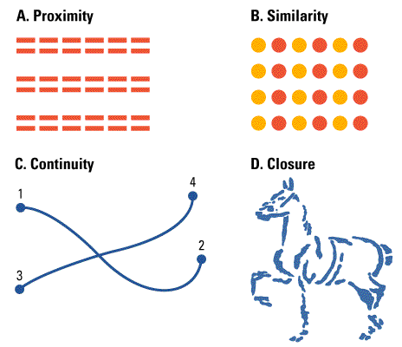
Figure and Ground
Proximity
  Seeing 3 pair of lines in A.
Similarity
  Seeing columns of orange and red dots in B.
Continuity
  Seeing lines that connect 1 to 2 and 3 to 4 in C.
Closure
  Seeing a horse in D.
Notes:
Figure 3.23 from:
Kassin, S. (1998). Psychology, second edition. Upper Saddle River, NJ: Prentice Hall.

Slide 4
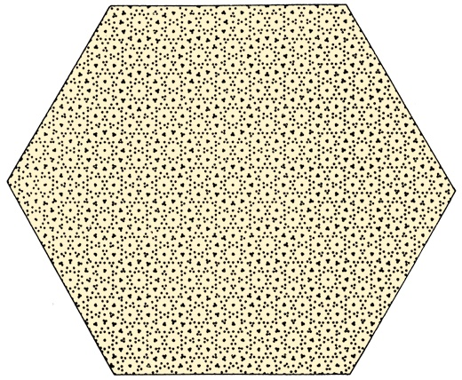
Gestalt and the Urge to Organize

Slide 5

Other gestalt principles
Simplicity

Slide 6
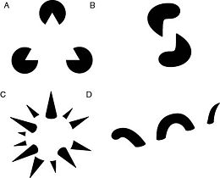
Gestalt Principles: Closure

Slide 7
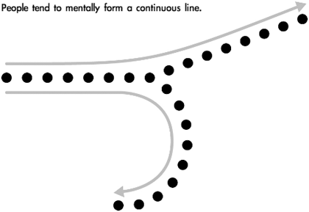
Gestalt Principles: Continuity

Slide 8
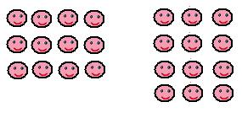
Gestalt Principles: Proximity

Slide 9
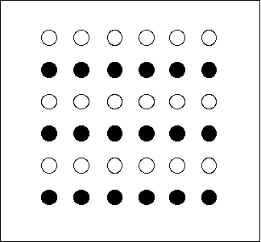
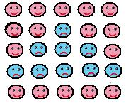
Gestalt Principles: Similarity

Slide 10
Depth and Distance Perception
Binocular Cues:
  Visual cues to depth or distance that require the use of both eyes.
  Convergence: Turning inward of the eyes, which occurs when they focus on a nearby object
  Retinal Disparity: The slight difference in lateral separation between two objects as seen by the left eye and the right eye.

Slide 11
Depth and Distance Perception
Monocular Cues:
  Visual cues to depth or distance that can be used by one eye alone.

Slide 12
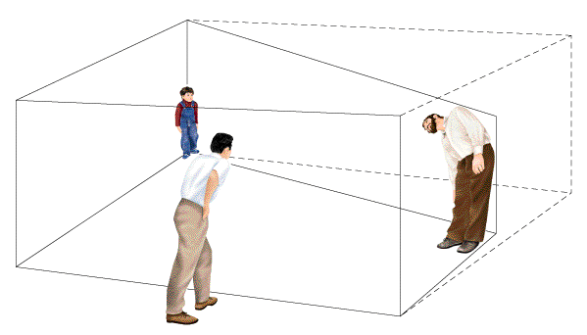
The Ames Room
A specially-built room that makes people seem to change size as they move around in it
The room is not a rectangle, as viewers assume it is
A single peephole prevents using binocular depth cues
Notes:
Figure 3.24 from:
Kassin, S. (1998). Psychology, second edition. Upper Saddle River, NJ: Prentice Hall.

Slide 13
Visual Constancies
The accurate perception of objects as stable or unchanged despite changes in the sensory patterns they produce.
  Shape constancy
  Location constancy
  Size constancy
  Brightness constancy
  Color constancy

Slide 14
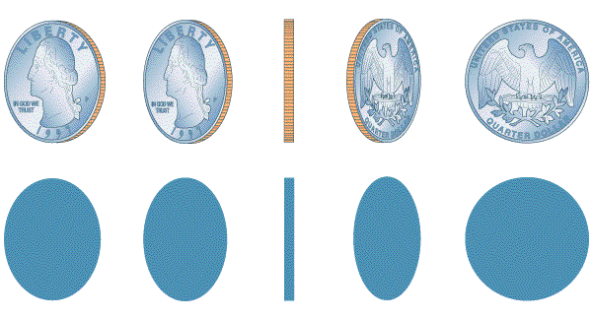
Shape Constancy
Even though these images cast shadows of different shapes, we still see the quarter as round
Notes:
Figure 3.25 from:
Kassin, S. (1998). Psychology, second edition. Upper Saddle River, NJ: Prentice Hall.

Slide 15
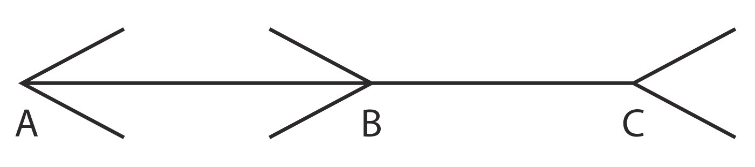
Muller-Lyon Illusion
Which is longer?

Slide 16
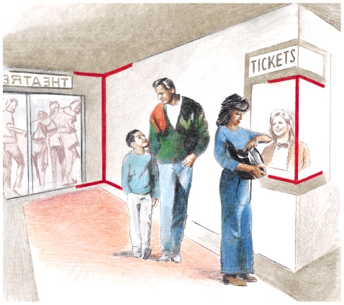
Muller-Lyon Illusion

Slide 17
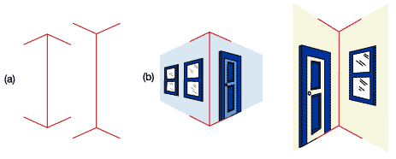
Visual
Illusions
Illusions are valuable in understanding perception because they are systematic errors.
  Illusions provide hints about perceptual strategies
In the Muller-Lyer illusion (above) we tend to perceive the line on the right as slightly longer than the one on the left.
Notes:
Figure 5.07 from
Wade, C., & Tavris, C. (2002). Invitation to Psychology, 2nd Ed. Upper Saddle River, NJ: Prentice Hall.

Slide 18
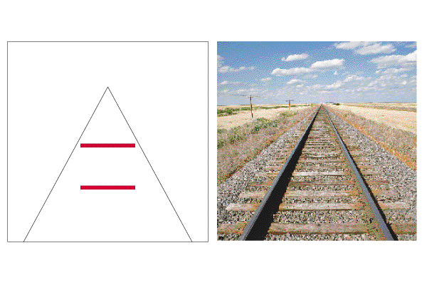
The Ponzo Illusion
Linear perspective provides context
Side lines seem to converge
Top line seems farther away
  But the retinal images of the red lines are equal!
Notes:
Figure 3.3Davis 2 from:
Kassin, S. (1998). Psychology, second edition. Upper Saddle River, NJ: Prentice Hall.

Slide 19
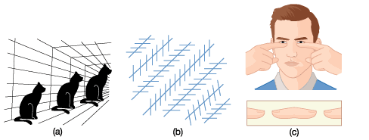
Fooling the Eye
The cats in (a) are the same size
The diagonal lines in (b) are parallel
You can create a “floating fingertip frankfurter” by holding hands as shown, 5-10” in front of face.

Slide 20
Perceptual Powers: Origins and Influences
Inborn abilities and perceptual lessons
Psychological and cultural Influences on perception

Slide 21
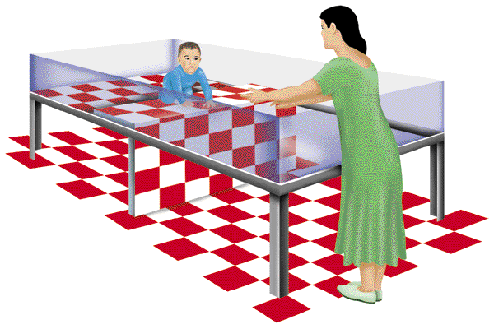
The Visual Cliff
Glass surface, with checkerboard underneath at different heights
  Visual illusion of a cliff
  Baby can’t fall
Mom stands across the gap
Babies show increased attention over deep side at age 2 months, but aren’t afraid until about the age they can crawl (Gibson & Walk, 1960)
Notes:
Figure 3.27 from:
Kassin, S. (2001). Psychology, third edition. Upper Saddle River, NJ: Prentice Hall.

Slide 22
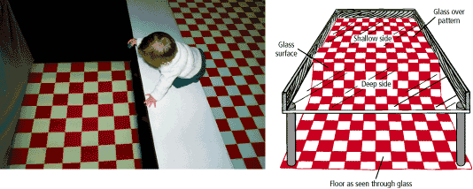
The Visual Cliff

Slide 23
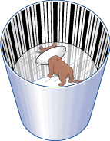
Critical Period
If infants miss out on experiences during a crucial period of time, perception will be impaired.
When adults who have been blind since birth have vision restored, they may not see well
Other senses such has hearing may be influenced similarly.

Slide 24
Psychological and Cultural Influences on Perception
We are more likely to perceive something when we need it.
What we believe can affect what we perceive.
Emotions, such as fear, can influence perceptions of sensory information.
Expectations based on our previous experiences influence how we perceive the world.
  Perceptual Set
    A habitual way of perceiving, based on expectations.
All are influenced by our culture.

Slide 25
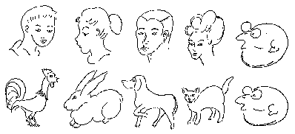
Perceptual Set

Slide 26
Perceptual Set

Slide 27
Perceptual Set

Slide 28
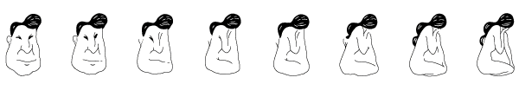
Perceptual Set
What you see in the center figures depends on the order in which you look at the figures:
  If you scan from the left, see an old man
  If you scan from the right, see a woman’s figure
Notes:
Figure 3.28 from:
Kassin, S. (1998). Psychology, second edition. Upper Saddle River, NJ: Prentice Hall.

Slide 29
Puzzles of Perception
Subliminal Perception
Extrasensory Perception: Reality or Illusion?

Slide 30
Extrasensory Perception
Extrasensory Perception (ESP):
  The ability to perceive something without ordinary sensory information
  This has not been scientifically demonstrated
Three types of ESP:
  Telepathy – Mind-to-mind communication
  Clairvoyance – Perception of remote events
  Precognition – Ability to see future events

Slide 31
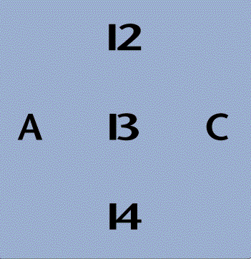
Context Effects
The same physical stimulus can be interpreted differently
We use other cues in the situation to resolve ambiguities
Is this the letter B or the number 13?
Notes:
Figure 3.Davis 29 from:
Kassin, S. (1998). Psychology, second edition. Upper Saddle River, NJ: Prentice Hall.

Slide 32
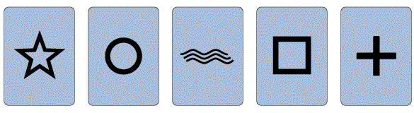
Parapsychology
J. B. Rhine conducted many experiments on ESP using stimuli such as these.
Rhine believed that his evidence supported the existence of ESP, but his findings were flawed.
Notes:
Figure 3.33 from:
Kassin, S. (1998). Psychology, second edition. Upper Saddle River, NJ: Prentice Hall.

Slide 33
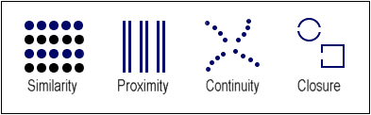
In order to make sense of our world our brains try to see patterns or shapes that are recognizable. This principle is called “grouping”.

Slide 34
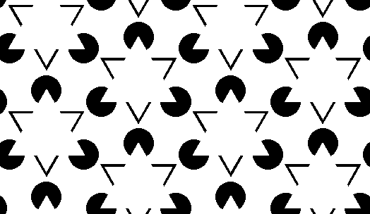
The mind forms shapes that don't exist.

Slide 35
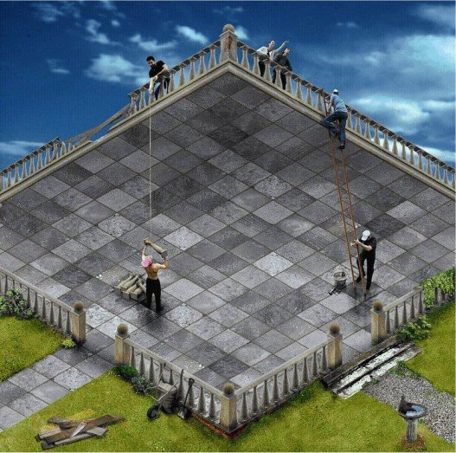

Slide 36
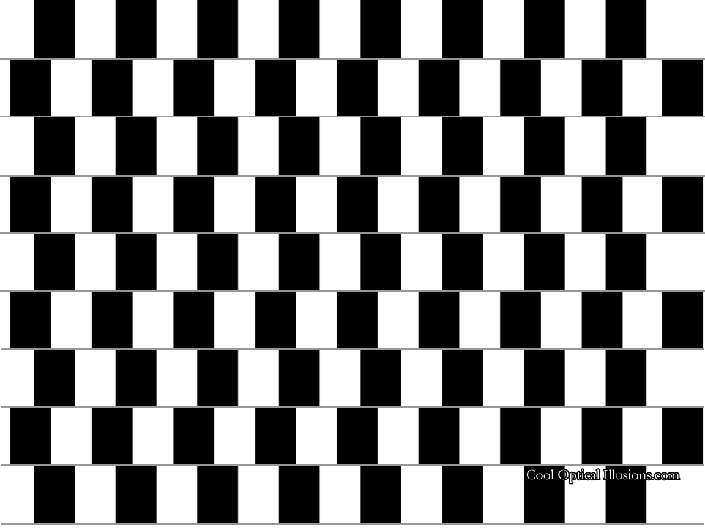
Parallel Lines?

Slide 37
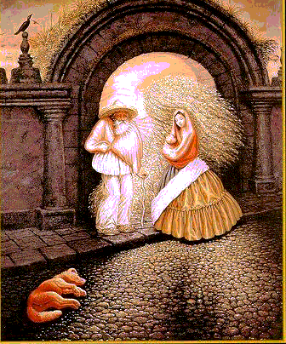
Embedded Images
http://psycharts.com/opt_illus.html

Slide 38
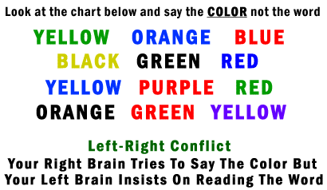

Slide 39
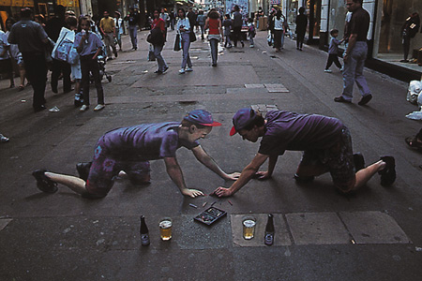
2 dimensional chalk drawing

Slide 40
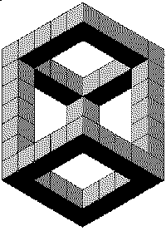

Slide 41

After a Necker cube is perceived from one perspective, it naturally tends to change to the other in about 3 seconds.

Slide 42
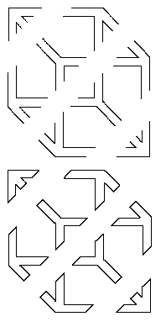
When you look at the top figure, your visual system will organize the elements into a box. The box will reverse, as in the Necker Cube illusion. The elements in the bottom figure have terminations and do not readily group into a box figure that shows reversals

Slide 43
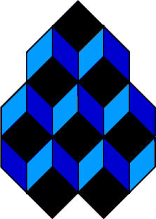
How fast do you switch?

Slide 44
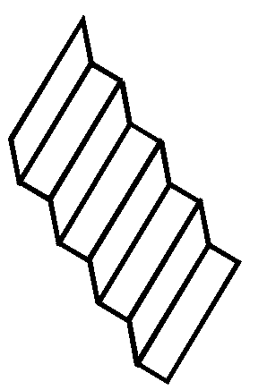
You will see it flip into a second staircase
M.C. Escher used complex variations on this illusion to achieve some wonderful effects like showing representations of people walking in opposite directions, both descending. He also joined staircases into an appearance of infinite ascent/descent.

Slide 45
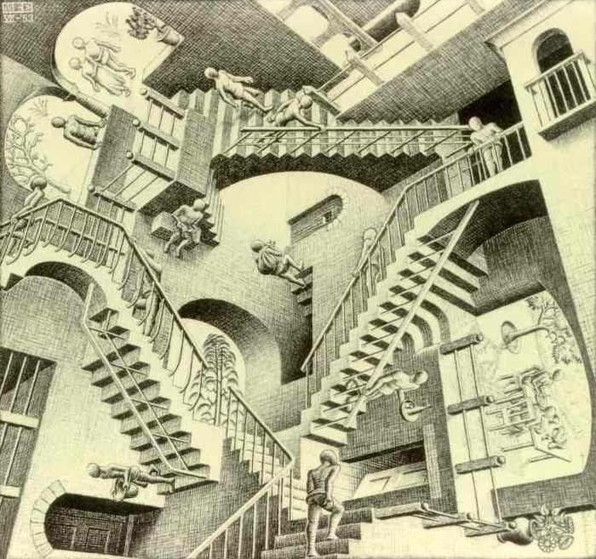
M.C. Escher

Slide 46
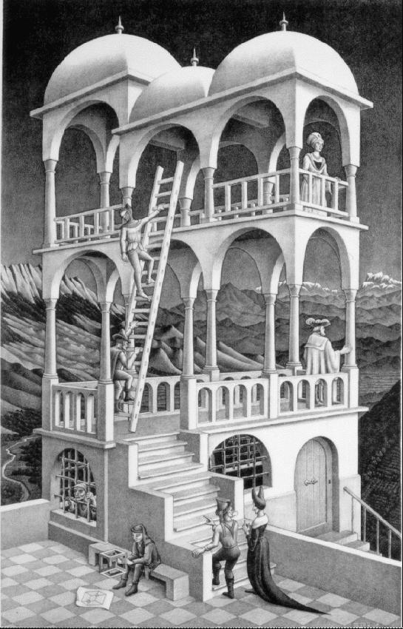

Slide 47
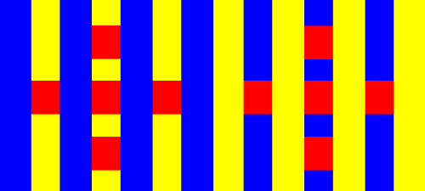
The shades of red are identical
The difference in the appearance is related to the influence of the backgrounds.
Compare the shades of red…

Slide 48

When you look at the figure you will see either a vase or two faces. If you continue to look, the figure will appear to shift to the alternative organization

Slide 49
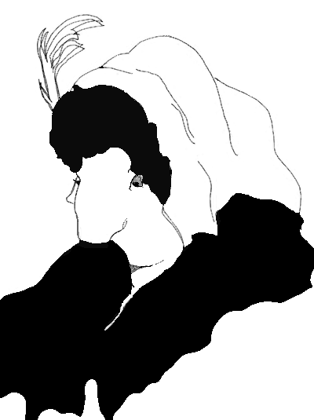
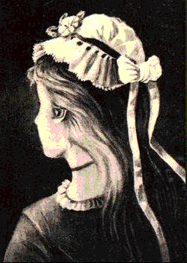
Old Woman or Young Girl?

Slide 50
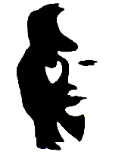
Man/Woman

Slide 51
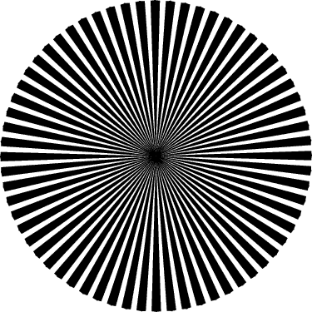
Shimmer

Slide 52
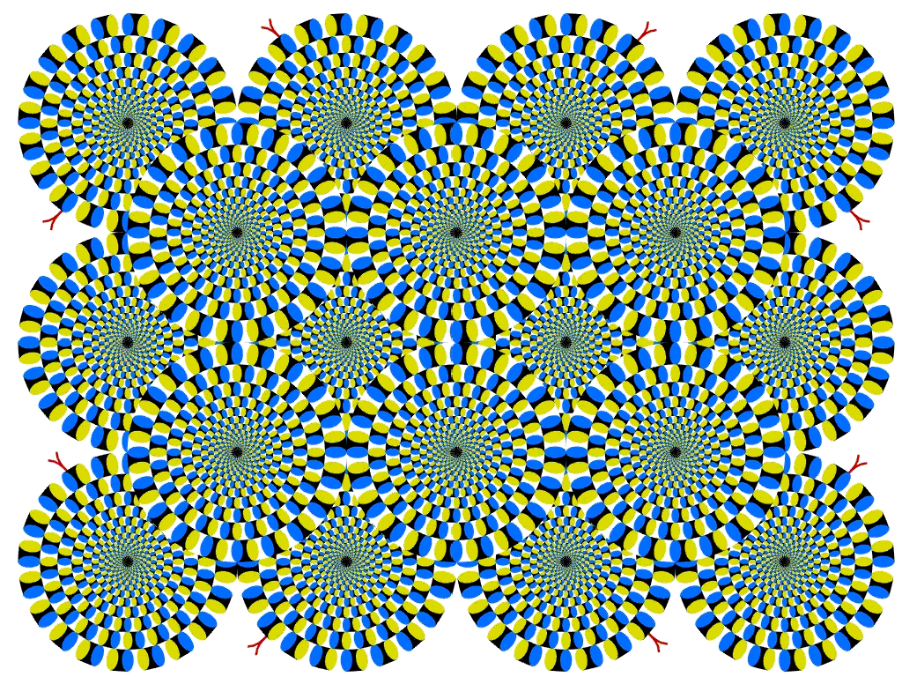
Any movement you see is an illusion!

Slide 53
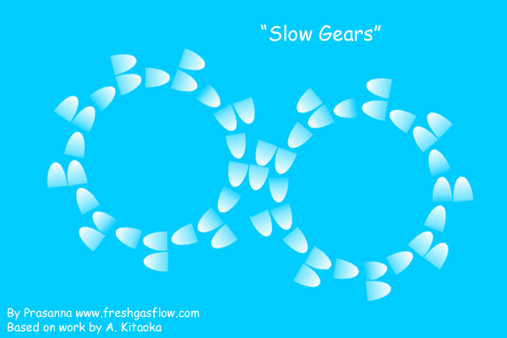

Slide 54
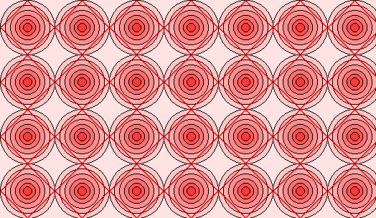
Straight Lines?

Slide 55
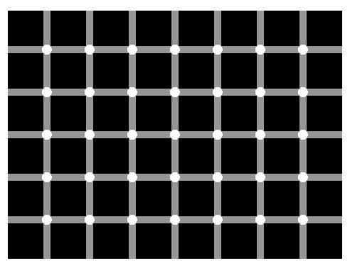
Hermann Grid

Slide 56
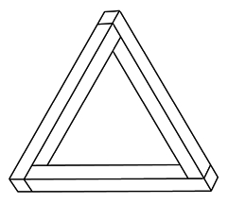
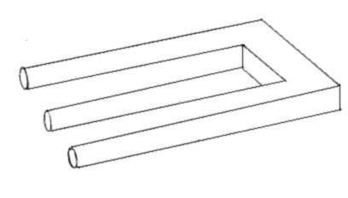
Impossible Triangle and Trident
http://psycharts.com/opt_illus.html

Slide 57
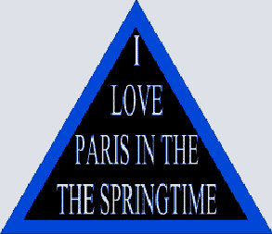
What is wrong with this sign?
http://www.keele.ac.uk/depts/aa/widening/uniworld/webclub/rs/optical.htm

Slide 58
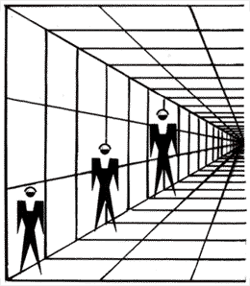
One more…
Perspective is evoked in this image by the pattern, and the lines on the wall which converge on to a common point in the distance.
http://www.sapdesignguild.org/resources/optical_illusions/perspective.html & http://www.killsometime.com/illusions/Optical-Illusion.asp?Illusion-ID=36

Slide 59

The End!

