Slide 1
Abnormal Psychological Disorders
Schizophrenia

Slide 2
Schizophrenia
Individuals can’t distinguish fantasy from reality
Experience disturbances in thinking, emotions, behaviors and perceptions
Confused and disconnected
1% of people worldwide
Delusions (false beliefs) can occur as well as hallucinations (perceptions with no external cue)
Speak very quickly
“word salad”
Psychotic Disorder
Much debate over cause
A Beautiful Mind

Slide 3
Types of Schizophrenia
Paranoid
Identified by hallucinations and delusions
Catatonic
Individual may sit for hours without moving
May move about wildly
Disorganized
Confused speech
Frequent and vivid hallucinations

Slide 4
Schizophrenic Disorders
About 1 in every 100 people are diagnosed with schizophrenia.
Symptoms of Schizophrenia
Disorganized thinking.
Disturbed Perceptions
Inappropriate Emotions and Actions

Slide 5
Disorganized Thinking
The thinking of a person with Schizophrenia is fragmented and bizarre and distorted with false beliefs.
Disorganized thinking comes from a breakdown in selective attention.- they cannot filter out information.

Slide 6
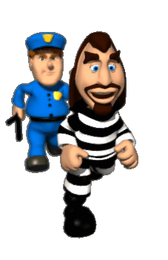
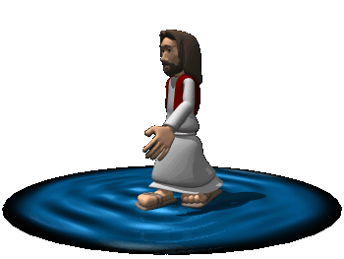
Delusions (false beliefs)
Delusions of Persecution
Delusions of Grandeur

Slide 7
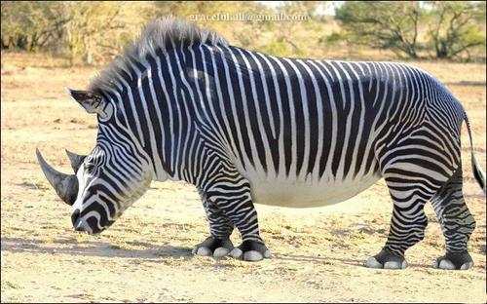
Disturbed Perceptions
hallucinations- sensory experiences without sensory stimulation.

Slide 8
Inappropriate Emotions and Actions
Laugh at inappropriate times.
Flat Effect
Senseless, compulsive acts.
Catatonia- motionless Waxy Flexibility

