Slide 1

An Introduction to the stuff you will be learning this year.

Slide 2
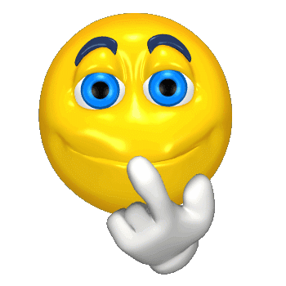
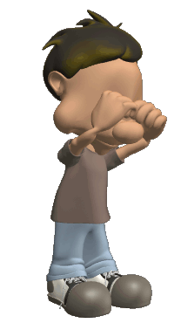

Psychology
What is it?
The study of our inner feelings and behaviors.
Do our feelings always match our behaviors?
If you call me a dummy, I may feel sad inside.
But I will still act tough.
(but I will be crying on the inside, so be gentle).

Slide 3
Break it down.
Psych….
What does the term “psyche” mean?
…ology
What’s an “ology?”
Your psyche deals with your mind…
…and ology the study of.
Hence, the study of your mind!

Slide 4

What is Psychology?
Psychology is the scientific study of behavior and mental processes
  Mental processes: Internal, subjective experiences we infer from behavior
    Examples: thoughts, dreams, perceptions, sensations, beliefs or feelings
  Behavior: Anything an organism does. Behavior is observable
    Examples: smiling, yelling blinking, sweating talking

Slide 5
How does Psychology relate to Science?
Psychology is a social science, but still a SCIENCE
  Psychologists use the scientific method
  Scientific Method: Process of gaining knowledge by identifying problems, forming hypothesis, and then testing hypothesis with observation, experimentation and analysis

Slide 6





Why Study Psychology?
Application to everyday life
Gain insight into behavior (yours and others)
Notes:
Application to everyday life = Potty training through shaping (reward and punishment)
Application to everyday life = Hypnosis and other techniques related to psychology can help you overcome an addiction like smoking.
Application to everyday life = Help you improve your memory
Application to everyday life = Get better grades
Gain insight into behavior = learn why someone you know is shy and withdrawn

Slide 7
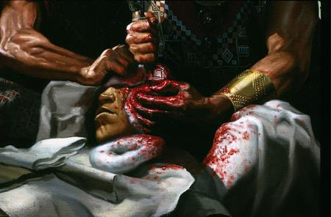
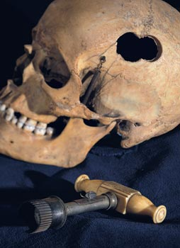
History of Psychology
Although the science of psychology started in the late 1800’s, the concept has been around a lot longer.
There was evidence of trephination (cutting holes into a skull to let evil spirits out) back in the stone age.
It was like a bad SAW movie!!!!

Slide 8
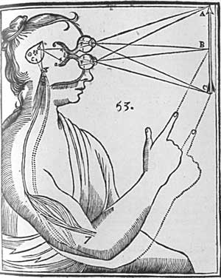
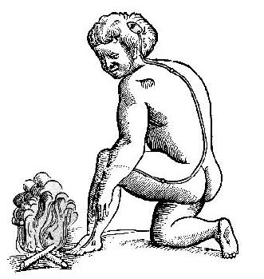
What are the Origins of Psychology?
Greek Philosophers
  Socrates and Plato first conceive the mind as separate and distinct from the body
Enlightenment Philosophers
  Rene Descartes: early ideas of the nervous system
  John Locke develops Blank Slate Theory: men are shaped by experience, not predisposition
  Locke and Francis Bacon come up with empiricism
    Empiricism: idea that knowledge and science should rely on observation and experimentation

Slide 9
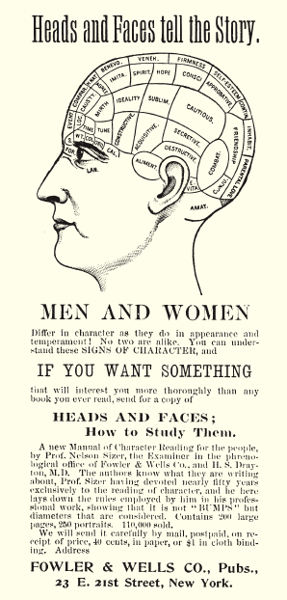
History of Psychology
Phrenology – Examining bumps on the skull to determine intellect and character traits (19th century)
Past attempts at understanding human behavior (weird or not) have led to what we know today and shaped the current Approaches to Psychology
Notes:
Phrenology encouraged psychologists to study the role of the brain, rather than the heart, in human behavior.

Slide 10
Goals of Psychology
Describe behavior
Explain behavior
Predict behavior
Influence behavior
Can you think of an example that illustrates each of the goals of Psychology?
Notes:
During the process of trying to explain human behavior, psychologists create hypothesis and test them. A hypothesis is an educated guess. They use the knowledge gained to create theories that will help them predict and influence human behavior.
Just like scientists, Psychologists use the scientific method of research
Can you think of an example that illustrates each of the goals of psychology?

Slide 11
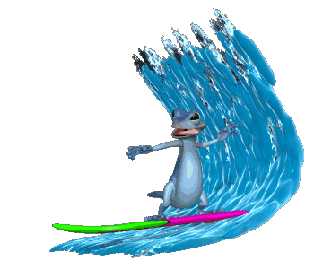
Waves of Psychology
The science of psychology has gone through about 5 different waves since it started.
Waves are different ways of thinking over time.

Slide 12
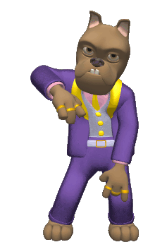
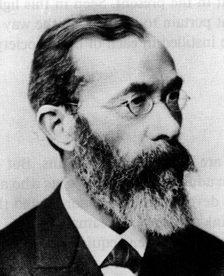
Wave One: Introspection
Kickin it old school
Started with Wilhelm Wundt’s first psychological laboratory and his concept of introspection (structuralism).
Introspection – When you attempt to analyze your own thoughts and feelings psychologically.
These guys were considered hot, back in the day!!!!

Slide 13
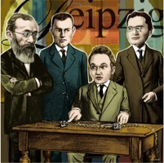
Psychology started on a cold December day in 1879…
…in a small room on the third floor of a shabby building at Germany’s University of Leipzig. There, two young men were helping a long-faced, austere, middle-aged professor, Wilhelm Wundt, create an experimental apparatus.
Their machine measured the time lag between people’s hearing a ball hit a platform and their pressing a telegraph key.
Later, the researchers compared this lag to the time required for slightly more complex tasks. Curiously, people responded in about one-tenth of a second when asked to press the key as soon as the sound occurred—and in about two-tenths of a second when asked to press the key as soon as they were aware of perceiving the sound. Wundt was seeking to measure “atoms of the mind”—the fastest and simplest mental processes.
Thus began what many consider psychology’s first experiment, launching the first psychology laboratory, staffed by Wundt and psychology’s first graduate students.

Slide 14
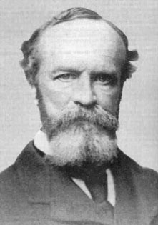
Introspection
Then William James wrote The Principles of Psychology and discussed functionalism.
In reality, these ideas do not have much impact on how psychologists think today.
It’s like an early Duck Dynasty TV show!

Slide 15
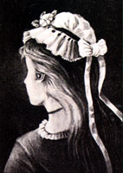
Wave Two: Gestalt Psychology
Led by Max Wertheimer, these guys focused not on how we feel, but on how we experience the world.
The whole of an experience can be more than the sum of its parts.
Think for a moment of all the reasons that you love your mom/dad.
If you add all those reasons up, do they equal your love for your mom/dad?
Hopefully not!!!
This may seem like one picture, but it can be perceived as 3 different faces. Can you find them?

Slide 16

Gestalt Example
When you look at a chair, you don’t see a flat surface and metal bars. You see the chair as a whole.

Slide 17
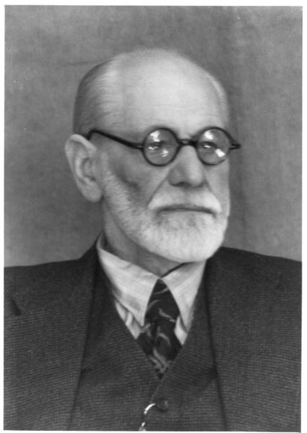
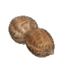
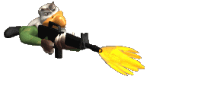
Wave Three: Psychoanalysis
This wave of thinking started with Sigmund Freud (in the early 1900’s).
In a nutshell, during this time period people believed that most of your feelings come from a hidden place in your mind called the unconscious.
We protect ourselves from our real feeling by using defense mechanisms.

Slide 18
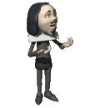
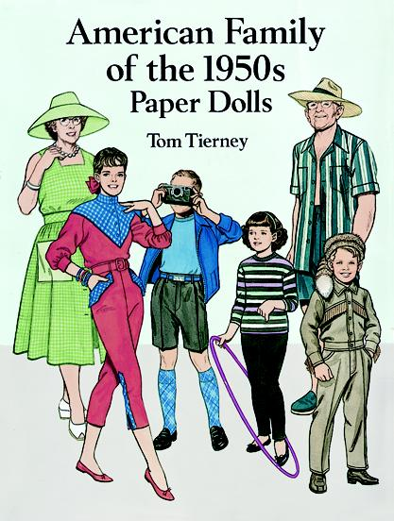
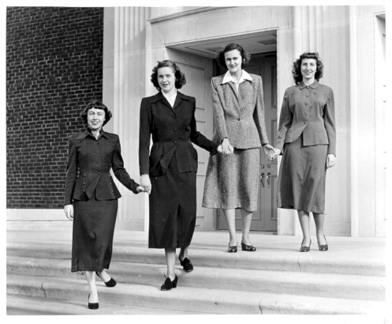
Wave Four: Behaviorism
During this time period (early to mid 1900s), people started to ignore how you feel inside.
All that mattered was how you acted.
If they could change your behavior, who cares how you feel.
Very popular during the conservative 1950’s when social appearance mattered more than self expression.

Slide 19
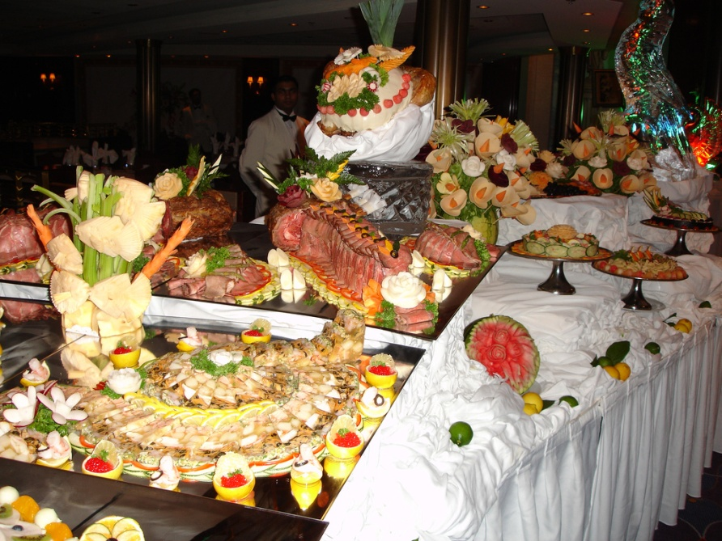

Wave Five: Eclectic
We are now in wave five….which is about variety.
Psychologists pick and choose what theories to use depending on the situation and the client.
Just like Ben 10 choosing the right alien to fight the bad guy depending the situation.

Slide 20

Wave Five is made up of about 6 different perspectives.
In other words, psychologists today, pick and choose from about 6 schools of thought to help you with your problems.
Thus we have:
THE SIX SCHOOLS OF PSYCHOLOGY

