Slide 1
Abnormal Psychological Disorders
Anxiety

Slide 2
Anxiety Disorders
Anxiety – general state of dread or uneasiness in response to imagined danger
Most common type of mental illness in US
Affects 40 million Americans annually
Generalized Anxiety Disorder – continuous or generalized anxiety
Phobic Disorder
Specific phobia – almost anything
Social phobia – speaking in public
Agoraphobia – fear of public place

Slide 3
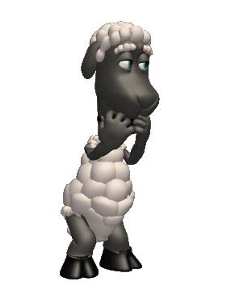
Anxiety Disorders
a group of conditions where the primary symptoms are anxiety or defenses against anxiety.
the patient fears something awful will happen to them.
They are in a state of intense apprehension, uneasiness, uncertainty, or fear.

Slide 4
Generalized Anxiety Disorder GAD
An anxiety disorder in which a person is continuously tense, apprehensive and in a state of autonomic nervous system arousal.
The patient is constantly tense and worried, feels inadequate, is oversensitive, can’t concentrate and suffers from insomnia.

Slide 5
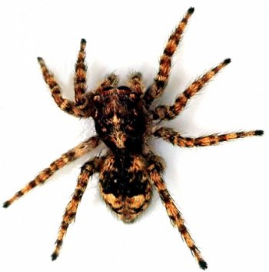
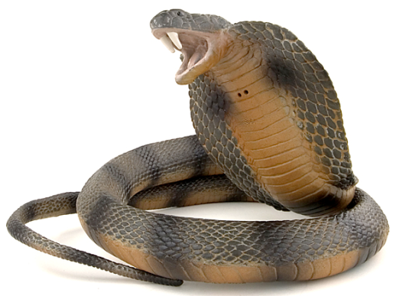
Anxiety Disorders
Phobia
Panic Disorder
OCD (As Good As it Gets, Matchstick Men)
Compulsions – repeating behaviors
Obsessions – uncontrollable thoughts
PTSD (Brothers, Reign Over Me)
Post-Traumatic Stress Disorder
Can be caused by any traumatic event (not just war)

Slide 6
Panic Disorder
An anxiety disorder marked by a minutes-long episode of intense dread in which a person experiences terror and accompanying chest pain, choking and other frightening sensations.

Slide 7
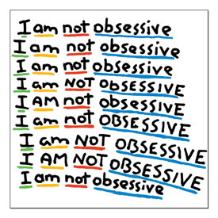
Obsessive-compulsive disorder
Persistent unwanted thoughts (obsessions) cause someone to feel the need (compulsion) to engage in a particular action.
Obsession about dirt and germs may lead to compulsive hand washing.

Slide 8
Post-traumatic Stress Disorder a.k.a. PTSD
Flashbacks or nightmares following a person’s involvement in or observation of an extremely stressful event.
Memories of the even cause anxiety.

Slide 9
Phobias
A person experiences sudden episodes of intense dread.
Must be an irrational fear.
Phobia List

