Slide 2
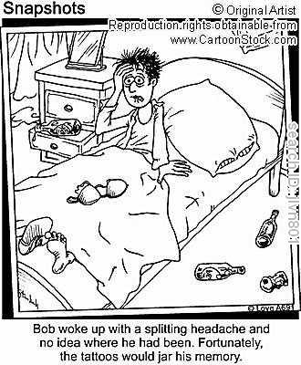
Long Term Memory
Unlimited storehouse of information.
Explicit (declarative) memories
Implicit (non-declarative) memories

Slide 3
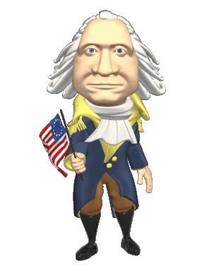
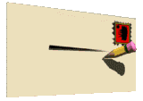
Explicit Memories (Conscious recollection of memories)
Episodic Memories
The memory of autobiographical events
Times, places, associated emotions, and other contextual knowledge
Can be explicitly stated.
Semantic Memories
Your memory for meanings and general (impersonal) facts.
Ideas, meanings, concepts

Slide 4
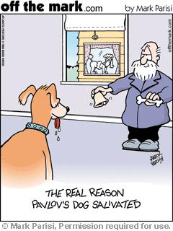
Implicit Memories (Individual is unable to verbally "declare" these memory)
Procedural Memories
Memory of how to perform tasks.
Conditioned Memories
Think of classical conditioning!
Memories that have been associated with a CR.

Slide 5
Take out a piece of paper and name all the Presidents…

Slide 6
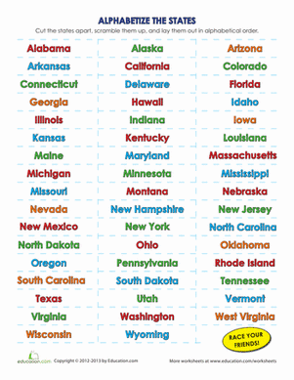
Can you name all of the states?

Slide 7
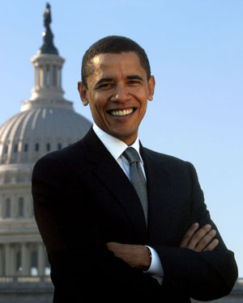
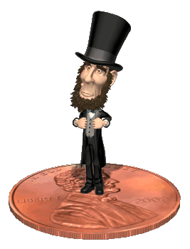
Encoding Information
Primacy Effect
The first number/letter/word in a list will be remembered the most.
Recency Effect
The last word heard in a list will be one of the most remembered.
Serial Positioning Effect

Slide 8
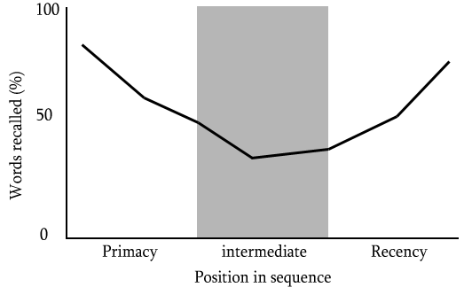

Slide 9
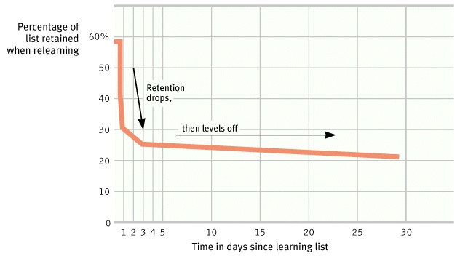
Spacing Effect
DO NOT CRAM!!!!!!!!!!!!
Ebbinghaus’s Forgetting Curve

Slide 10
The Ways we can encode…
Encoding Exercise
Visual Encoding: the encoding of picture images.
Acoustic Encoding: the encoding of sound, especially the sounds of words.
Semantic Encoding: the encoding of meaning.

Slide 11
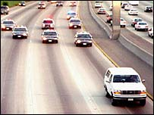
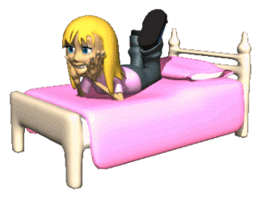
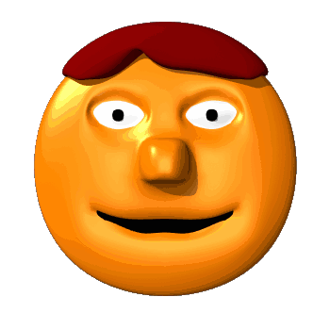
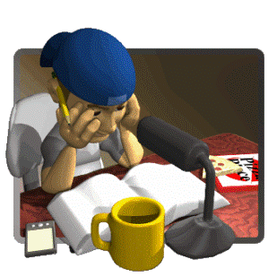
The Context Matters!!!
Flashbulb Memories
Distinctly vivid, precise, concrete, long-lasting memories of a personal circumstance
Mood Congruent Memory
Happy people will better remember happy than sad materials, whereas sad people will better remember sad materials better than happy people
State Dependent Memory
You remember best when you are in the same state when you learned it.

Slide 12
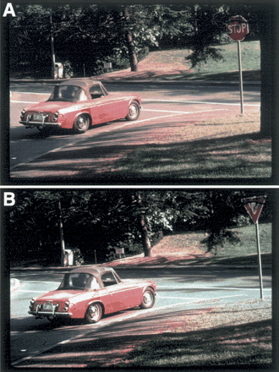
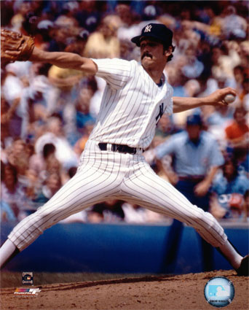
Constructive Memory
Memories are not always what they seem.
Elizabeth Loftus
A constructed memory is a created memory.
Misinformation effect

Slide 13
Forgetting

Slide 14
Forgetting
Getting a new bus number and forgetting old bus number.
Retroactive Interference: new information blocks out old information.
Proactive Interference: old information blocks out new information.
Calling your new girlfriend by old girlfriends name.

Slide 15
Storing Memories
Long Term-Potentiation
long-lasting enhancement in signal transmission between two neurons that results from stimulating them synchronously.
In other words…they learn to fire together and get better at it…creating a memory.

