Slide 1
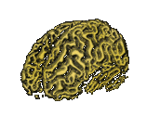
The Brain
Made up of neurons and glial cells.
Glial cells support neural cells.
Your parents are glial cells. They take care of you!

Slide 2
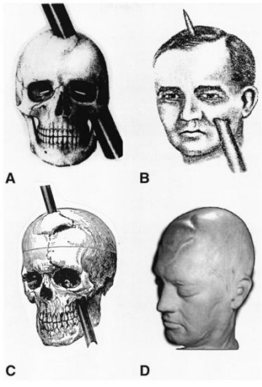
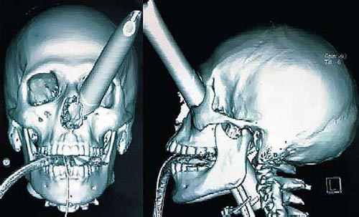
Ways to study the Brain!!!
Accidents: Phineas Gage.
Left frontal lobe damaged.
Changed personality and behavior
Friends called him “no longer Gage”
Notes:
Gage was a foreman for a railroad company in the 1800s. A rock blasting accident caused a rod to go through his head, destroying much of his brain’s left frontal lobe.

Slide 3
Invasive Ways to Study the Brain: Lesions
Cutting into the brain and looking for change.
A lesion is an area of the body where damage has occurred.
Brain tumors also lesion brain tissue.

Slide 4
Studying the Living Human Brain
Animal studies and clinical observations are useful, but often, such as when we need to diagnose or treat illness, we want to know what is happening inside the brain of a living human.
For this we have:
EEG: Electroencephalogram
MRI: Magnetic resonance imaging
PET Scan: Positron emission tomography
CT Scan (or CAT Scan): Computerized Tomography
Notes:
CT (computerized tomography) uses a sophisticated X ray machine combined with a computer to create a detailed picture of the body’s tissues and structure. Usually a special dye called a contrast material will be injected prior to the scan. This makes it easier to see abnormal tissue due to specific absorption rates.

Slide 5
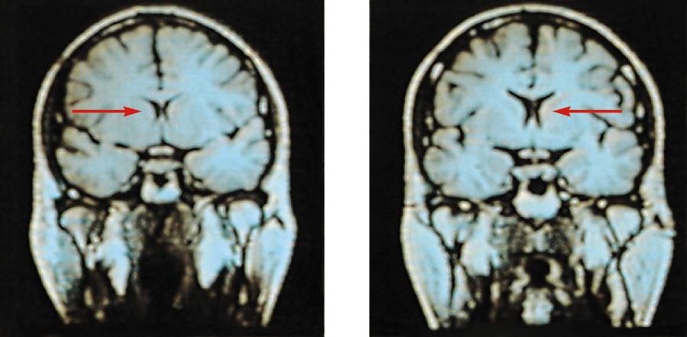
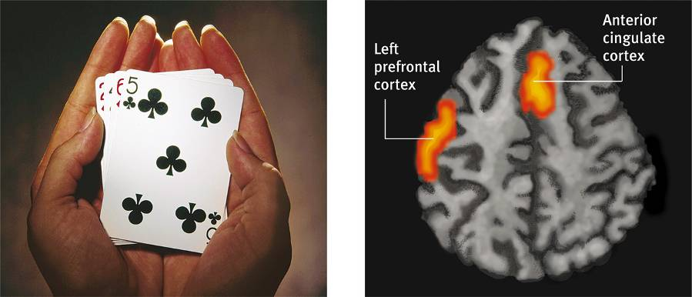
MRI: Magnetic Resonance Imaging
MRI uses magnetic fields and radio waves to produce computer-generated images that distinguish among different types of brain tissue.
Top images show ventricular enlargement in a schizophrenic patient.
Bottom image shows brain regions when a participants lies.
fMRI reveals a brain’s function as well as its structure by monitoring blood flow.
Both photos from Daniel Weinberger, M.D., CBDB, NIMH
James Salzano/ Salzano Photo
Lucy Reading/ Lucy Illustrations

Slide 6
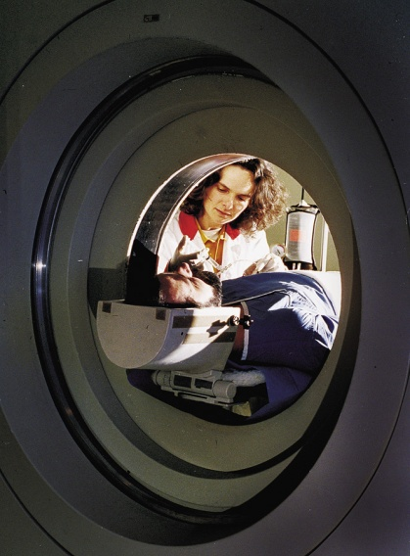
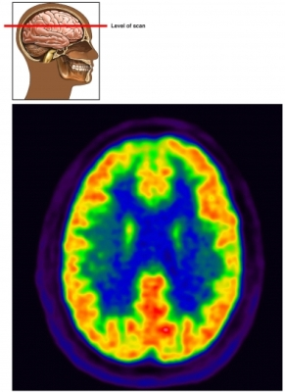
PET Scan: Positron Emission Tomography
PET Scan is a visual display of brain activity
Detects gamma rays emitted by a radioactive form of glucose while the brain performs a given task.
Courtesy of National Brookhaven National Laboratories

Slide 7
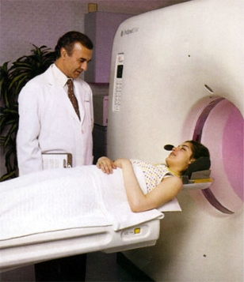
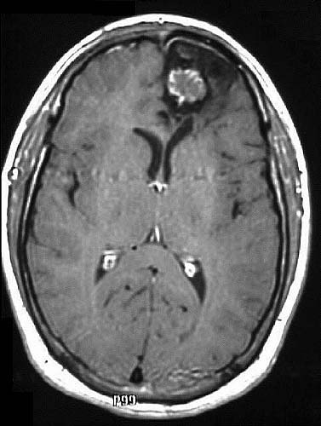
CT Scan: Computerized Tomography
X-ray rotates around head.
May be done with or without contrasting dye.
Images taken from different angles are assembled into 3-D image
CT scan produces much more detailed image than x-ray of bone and soft tissue
Notes:
A CT or CAT scan (computed tomography) is a much more sensitive imaging technique than x-ray, allowing high definition not only of the bony structures, but of the soft tissues. Clear images of organs such as the brain, muscles, joint structures, veins and arteries, as well as anomalies like tumors and hemorrhages may be obtained with or without the injection of contrasting dye.

Slide 8
Brain Structures
Some scientists divide the brain up into three parts:
Hindbrain
Midbrain
Forebrain

Slide 9
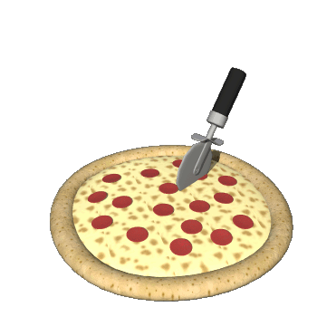
Cerebral Cortex
Top layer of our brain.
Contains wrinkles called fissures.
The fissures increase surface area of our brain.
Laid out it would be about the size of a large pizza.

Slide 10
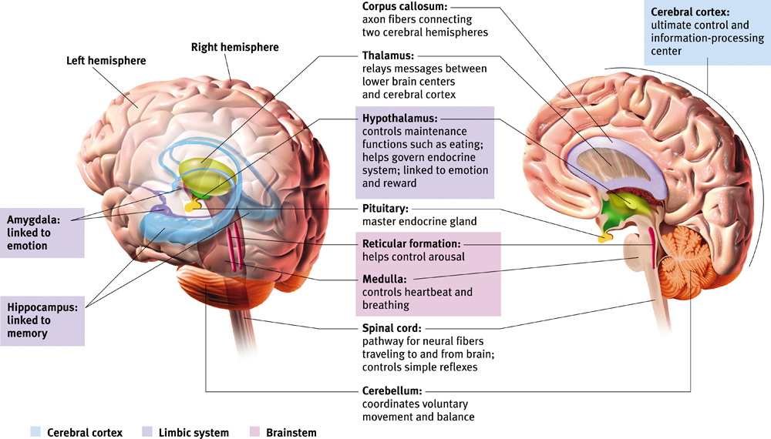
The Cerebral Cortex
The intricate fabric of interconnected neural cells that covers the cerebral hemispheres. It is the body’s ultimate control and information processing center.

Slide 11
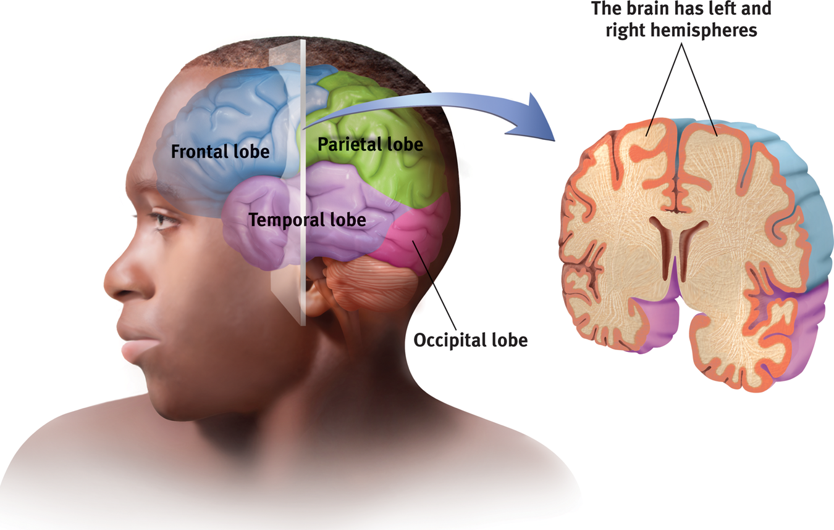
Structure of the Cortex
Each brain hemisphere is divided into four lobes
Frontal Lobe: Speaking, muscle movements, making plans and judgments.
Notes:
Preview Question 7: What are the four lobes of the cerebral cortex, and where are they located?

Slide 12
Functions of the Cortex
The Motor Cortex is the area at the rear of the frontal lobes that control voluntary movements.
The Sensory Cortex (parietal cortex) receives information from skin surface and sense organs.
Notes:
Preview Question 8: What are the functions of the cerebral cortex?

Slide 13
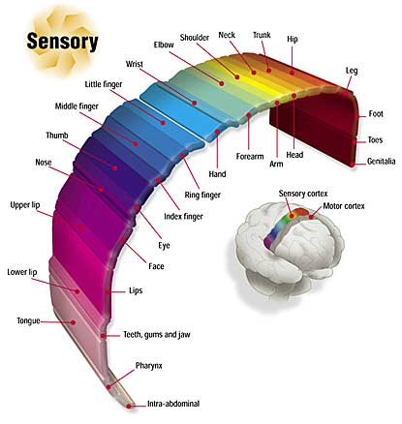
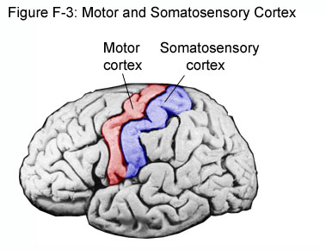
Notes:
Preview Question 8: What are the functions of the cerebral cortex?

Slide 14
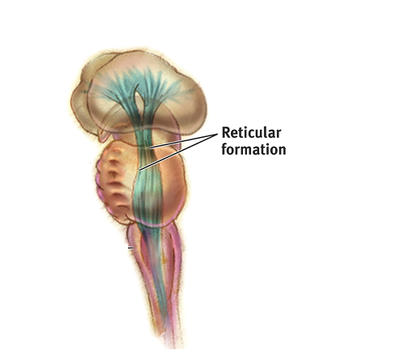
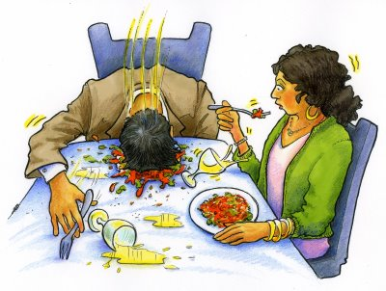
Reticular Formation
Reticular Formation is a nerve network in the brainstem that plays an important role in controlling arousal.
Damage to this causes a disorder called narcolepsy in which a person falls asleep suddenly during the daytime and cannot resist the sleep.

Slide 15
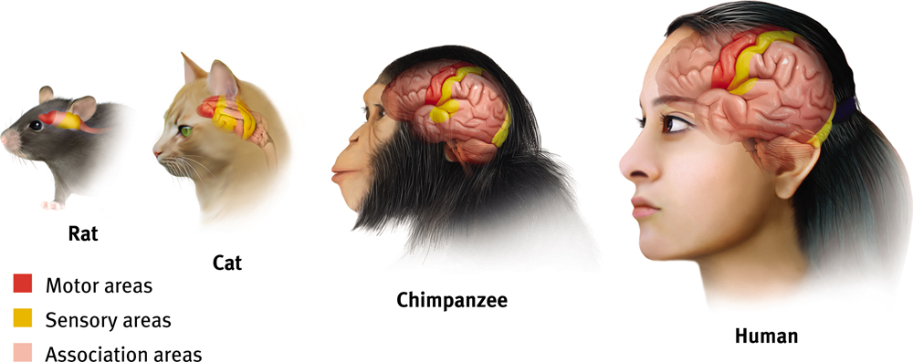
Association Areas
More intelligent animals have increased “uncommitted” or association areas of the cortex. These areas are responsible for integrating and acting on information received and processed by sensory areas.

Slide 16
Areas of the Cerebral Cortex
Divided into eight lobes, four in each hemisphere (frontal, parietal, occipital and temporal).
Any area not dealing with our senses or muscle movements are called association areas.

Slide 17
Frontal Lobe
Deals with planning, maintaining emotional control and abstract thought.
Contains Broca’s Area.
Broca’s Aphasia.
Contains Motor Cortex.

Slide 18
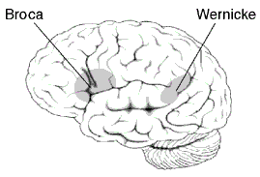
Language
Broca’s
Location = Frontal lobe
Produces language
Damage to this area causes problems creating speech.
Wernicke’s
Location = temporal lobe
Effects understanding of written and spoken language

Slide 19
Parietal Lobes
Located at the top of our head.
Contains the somato-sensory cortex.
Rest are association areas.

Slide 20
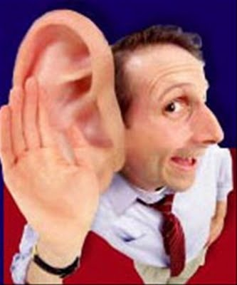
Temporal Lobes
Process sound sensed by ears.
Contains Wernicke’s area.
Wernicke’s Aphasia (see video).

Slide 21
Occipital Lobes
In the back of our head.
Handles visual input from eyes.
Right half of each retina goes to left occipital lobe and vice versa.

