Slide 1
Limbic System
EMOTIONAL CONTROL CENTER of the brain.
Made up of Hypothalamus, Amygdala and Hippocampus.

Slide 2
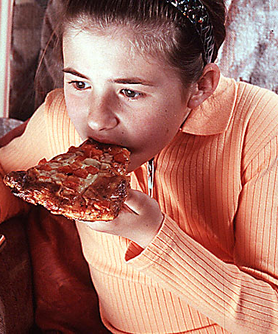
Hypothalamus
Hypothalamus lies below (hypo) the thalamus.
Directs maintenance activities like eating, drinking, body temperature, and control of emotions.
It stimulates or inhibits pituitary gland → other endocrine glands
Notes:
Endocrine system = secreting hormones

Slide 3
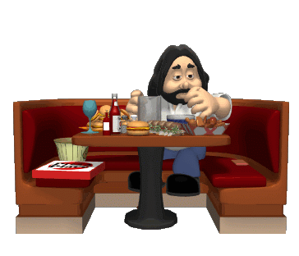
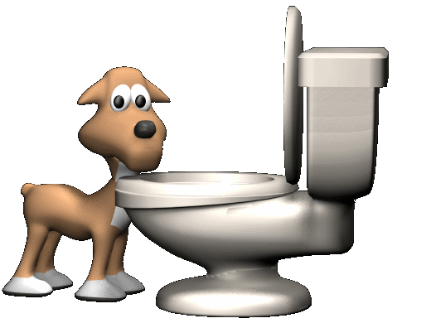
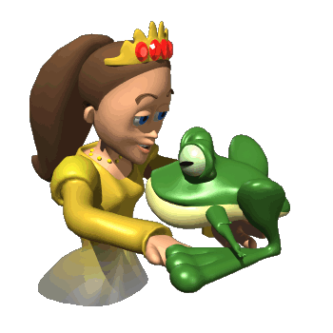
Hypothalamus
Pea sized in brain, but plays a, not so pea sized, role.
Body temperature
Hunger
Thirst

Slide 4
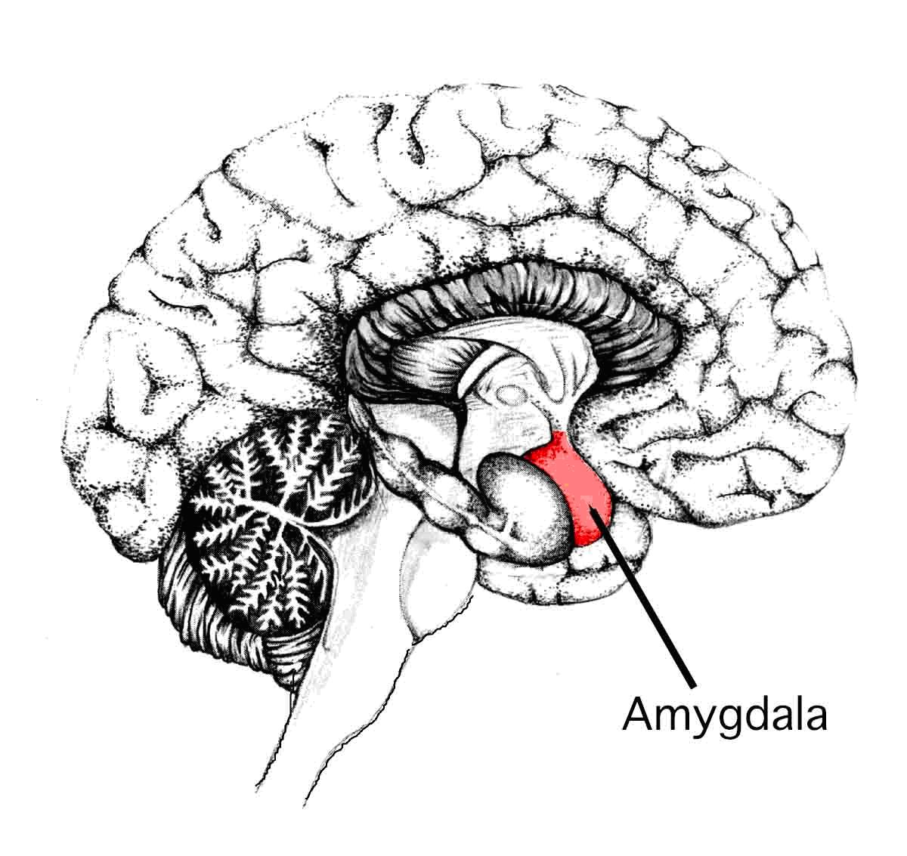
Amygdala
The Amygdala [ah-MIG-dah-la] consists of two lima bean-sized neural clusters linked to the emotions of fear and anger.

Slide 5
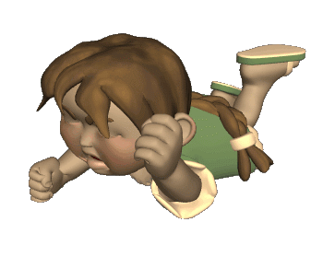
Hippocampus and Amygdala
Amygdala is vital for our basic emotions.
Hippocampus is involved in memory processing.

Slide 6
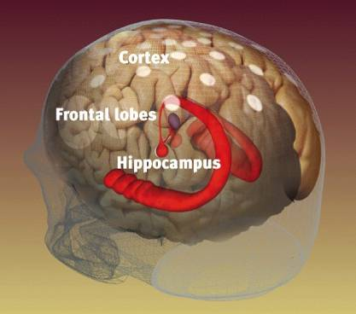
Hippocampus
Hippocampus – a neural center in the limbic
system that processes explicit memories.
Weidenfield & Nicolson archives

Slide 7
Storing Implicit & Explicit Memories
Explicit Memory refers to facts and experiences that one can consciously know and declare. Implicit memory involves learning an action while the individual does not know or declare what she knows.

Slide 8
Anterograde Amnesia
After losing his hippocampus in surgery, patient Henry M. (HM) remembered everything before the operation but cannot make new memories. We call this anterograde amnesia.
Anterograde
Amnesia
(HM)
Memory Intact
No New Memories
Surgery

Slide 9
Implicit Memory
HM is unable to make new memories that are
declarative (explicit), but he can form new
memories that are procedural (implicit).
A
B
C
HM learned the Tower of Hanoi (game) after his surgery. Each time he plays it, he is unable to remember the fact that he has already played the game.

Slide 10
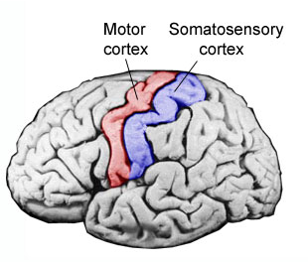
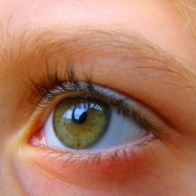
Thalamus
The Thalamus [THAL-uh-muss] is the brain’s sensory switchboard, located on top of the brainstem.
It directs messages to the sensory areas in the cortex and transmits replies to the cerebellum and medulla.
1.
2.
3.
4.
To cerebellum
To medulla

Slide 11
Thalamus
In Forebrain
Receives sensory information and sends them to appropriate areas of forebrain.
Like a switchboard.
Everything but smell.

Slide 12
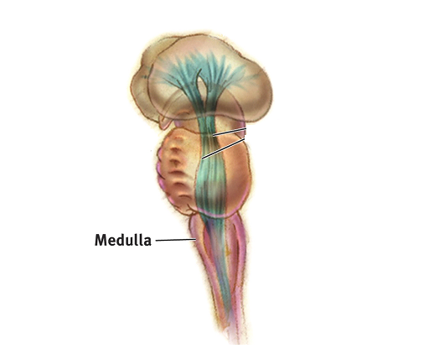
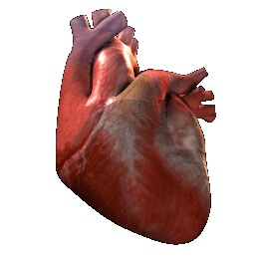
Medulla
The Medulla [muh-DUL-uh] is the base of the brainstem that controls heartbeat and breathing.

Slide 13
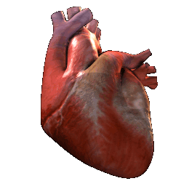
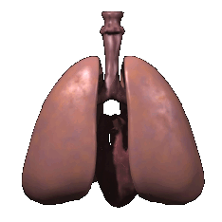
Medulla Oblongata
Heart rate
Breathing
Blood Pressure

Slide 14
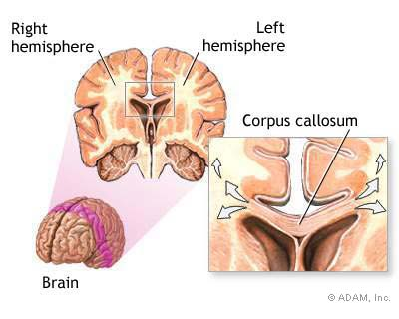

Slide 15
Split Brain Patients
With the corpus callosum severed, objects (apple) presented in the right visual field can be named. Objects (pencil) in the left visual field cannot.

Slide 16
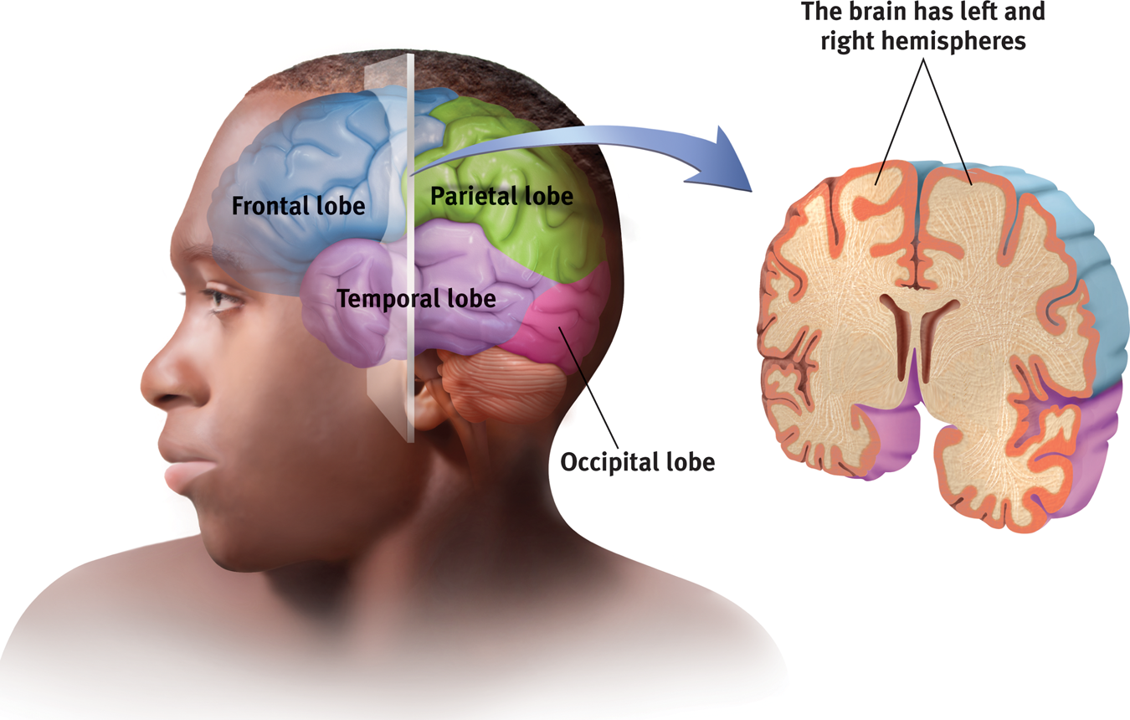
Structure of the Cortex
Each brain hemisphere is divided into four lobes
Frontal Lobe: Speaking, muscle movements, making plans and judgments.
Notes:
Preview Question 7: What are the four lobes of the cerebral cortex, and where are they located?

Slide 17
Functions of the Cortex
The Motor Cortex is the area at the rear of the frontal lobes that control voluntary movements.
The Sensory Cortex (parietal cortex) receives information from skin surface and sense organs.
Notes:
Preview Question 8: What are the functions of the cerebral cortex?

Slide 18
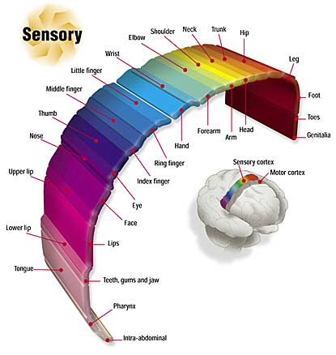
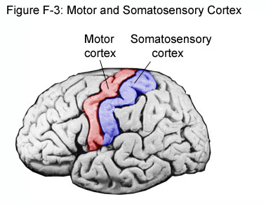
Notes:
Preview Question 8: What are the functions of the cerebral cortex?

Slide 19
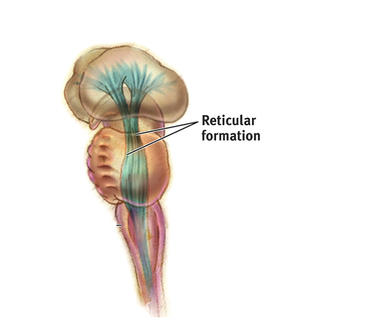
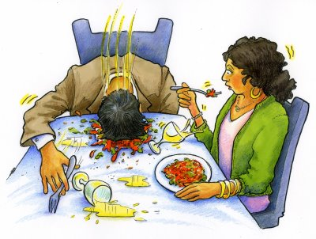
Reticular Formation
Reticular Formation is a nerve network in the brainstem that plays an important role in controlling arousal.
Damage to this causes a disorder called narcolepsy in which a person falls asleep suddenly during the daytime and cannot resist the sleep.

Slide 20
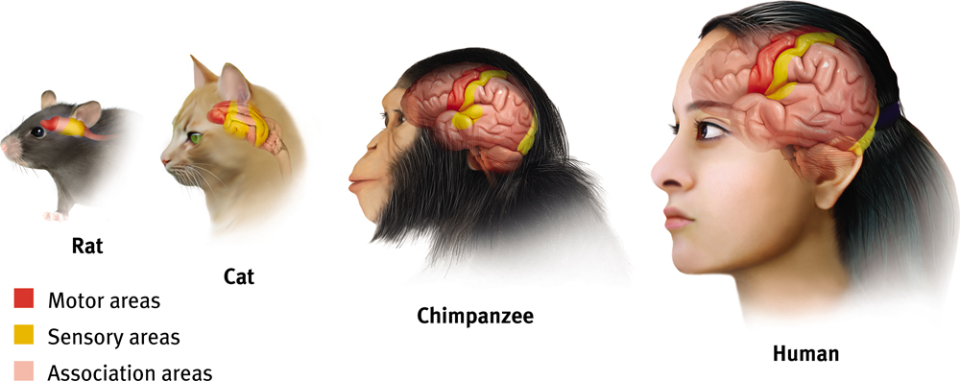
Association Areas
More intelligent animals have increased “uncommitted” or association areas of the cortex. These areas are responsible for integrating and acting on information received and processed by sensory areas.

Slide 21
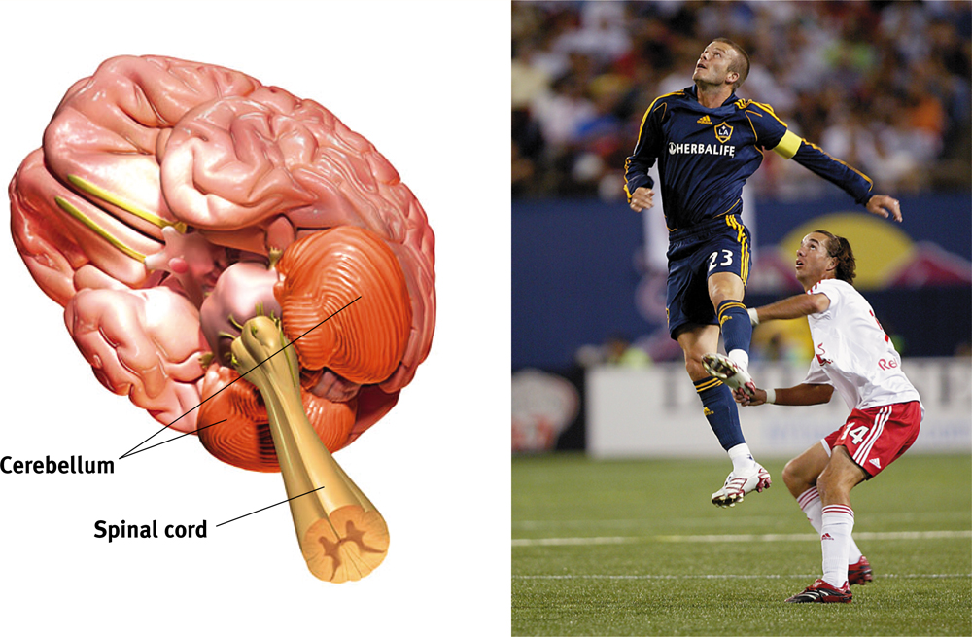
Cerebellum
The “little brain” attached to the rear of the brainstem.
It helps coordinate voluntary movements and balance.
Implicit (procedural) memory.

Slide 22
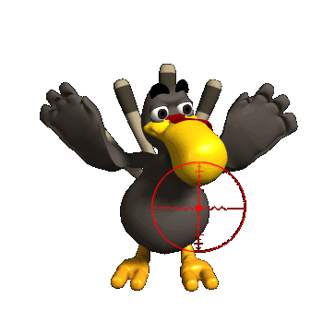
Cerebellum
Located in the back of our head- means little brain.
Coordinates muscle movements.
Like tracking a target.

Slide 23
Hemispheres
Divided into a left and right hemisphere.
Contralateral controlled- left controls right side of body and vice versa.
Brain Lateralization.
Lefties are better at spatial and creative tasks.
Righties are better at logic.

Slide 24
Split-Brain Patients
Corpus Collosum attaches the two hemispheres of cerebral cortex.
When removed you have a split-brain patient.

Slide 25
