Slide 1
Abnormal Psychological Disorders
Somatoform & D.I.D.

Slide 2
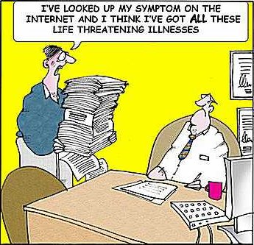
Somatoform Disorders
Classified as two types:
Conversion disorder
Person complains about a specific symptom with no apparent cause
Hypochondriasis
Person worries about becoming ill

Slide 3
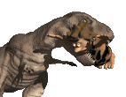
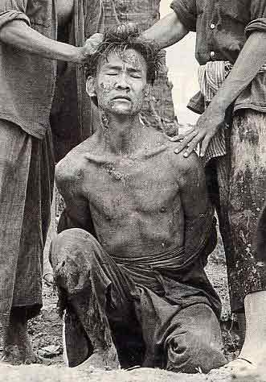
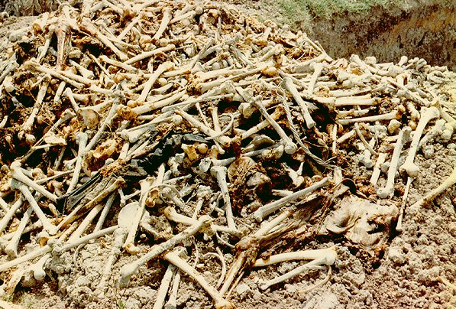
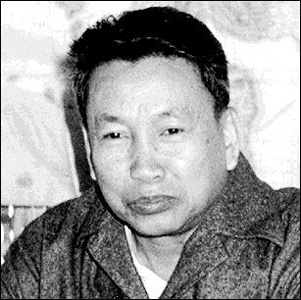
Conversion Disorder
Report the existence of severe physical problems with no biological reason.
Like blindness or paralysis.
Pol Pot

Slide 4
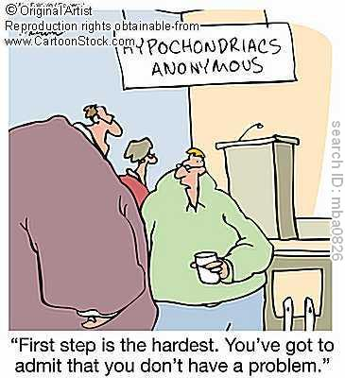
Hypochondriasis
Has frequent physical complaints for which medical doctors are unable to locate the cause.
They usually believe that the minor issues (headache, upset stomach) are indicative are more severe illnesses.

Slide 5
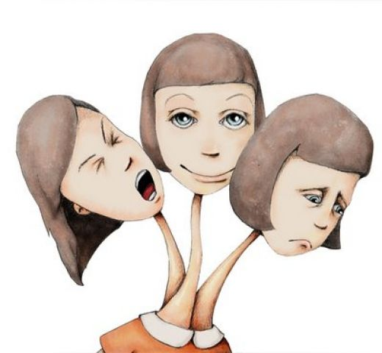
Dissociative Disorders
Alterations in memory, identity, or consciousness
Dissociative amnesia
Inability to recall personal events (rest of memory intact)
Dissociative fugue
Travels away from home or work & unable to recall past
DID – Dissociative Identity Disorder (United States of Tara)
Formerly Multiple Personality Disorder
Two or more distinct personalities
Rare and controversial

Slide 6
Psychogenic Amnesia
A person cannot remember things with no physiological basis for the disruption in memory.
Retrograde Amnesia
NOT organic amnesia.
Organic amnesia can be retrograde or antrograde.

Slide 7
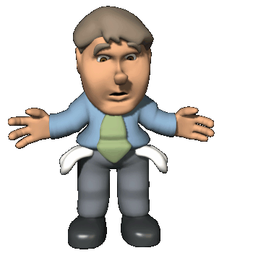
Dissociative Fugue
People with psychogenic amnesia that find themselves in an unfamiliar environment.

Slide 8
Dissociative Identity Disorder
Used to be known as Multiple Personality Disorder.
A person has several rather than one integrated personality.
People with DID commonly have a history of childhood abuse or trauma.

