Slide 1
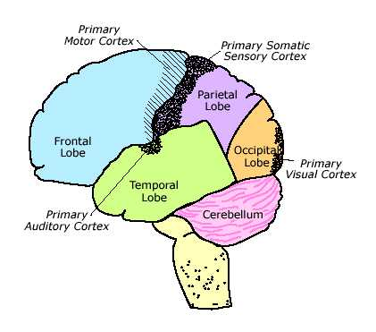
Phase Four: In the Brain
Goes to the Visual Cortex located in the Occipital Lobe of the Cerebral Cortex.
Feature Detectors.
Parallel Processing
We have specific cells that see the lines, motion, curves and other features of objects. These cells are called “feature detectors.”

Slide 2
Color Vision
Two Major Theories

Slide 3
Trichromatic Theory
Three types of cones:
Red
Blue
Green
These three types of cones can make millions of combinations of colors.
Does not explain afterimages or color blindness well.

Slide 4
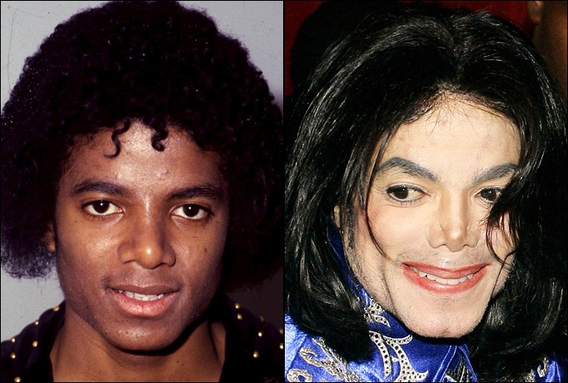
Opponent-Process theory
The sensory receptors come in pairs.
Red/Green
Yellow/Blue
Black/
If one color is stimulated, the other is inhibited.
White

Slide 5
Why the Visual System is not a Camera
Much visual processing is done in the brain.
Some cortical cells respond to lines in specific orientations (e.g. horizontal).
Other cells in the cortex respond to other shapes (e.g., bulls-eyes, spirals, faces).
Feature-detectors
Cells in the visual cortex that are sensitive to specific features of the environment.

Slide 6
Hubel & Wiesel’s Experiment

Slide 7
Test of Color Deficiency
Notes:
Figure 3.12 from:
Kassin, S. (1998). Psychology, second edition. Upper Saddle River, NJ: Prentice Hall.

Slide 8
Afterimages

Slide 9
Afterimages
Notes:
Figure 3.10 from:
Kassin, S. (1998). Psychology, second edition. Upper Saddle River, NJ: Prentice Hall.

Slide 11
Hearing
Our auditory sense

Slide 12
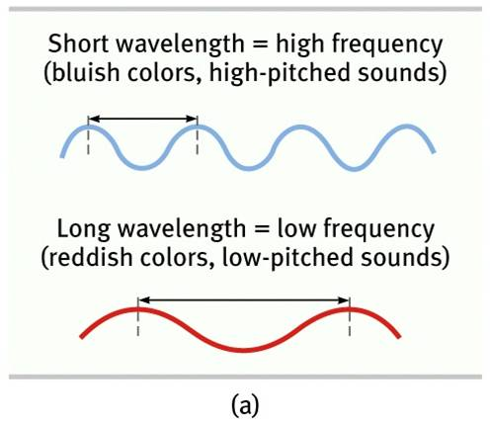
We hear sound WAVES
The height of the wave gives us the amplitude of the sound.
The frequency of the wave gives us the pitch if the sound.

Slide 13
The Ear

Slide 14
Transduction in the ear
Sound waves hit the eardrum then anvil then hammer then stirrup then oval window.
Everything is just vibrating.
Then the cochlea vibrates.
The cochlea is lined with mucus called basilar membrane.
In basilar membrane there are hair cells.
When hair cells vibrate they turn vibrations into neural impulses which are called organ of Corti.
Sent then to thalamus up auditory nerve.
It is all about the vibrations!!!

Slide 15
Pitch Theories
Place Theory and Frequency Theory

Slide 16
Place Theory
Different hairs vibrate in the cochlea when they different pitches.
So some hairs vibrate when they hear high and other vibrate when they hear low pitches.

Slide 17
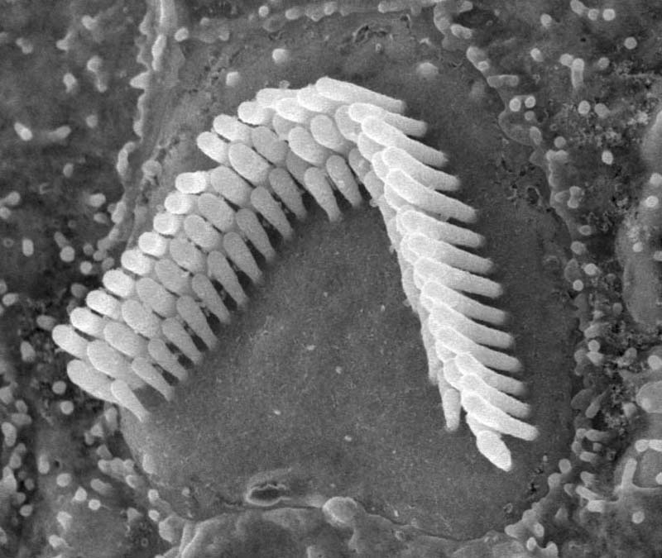
Frequency Theory
All the hairs vibrate but at different speeds.

Slide 18
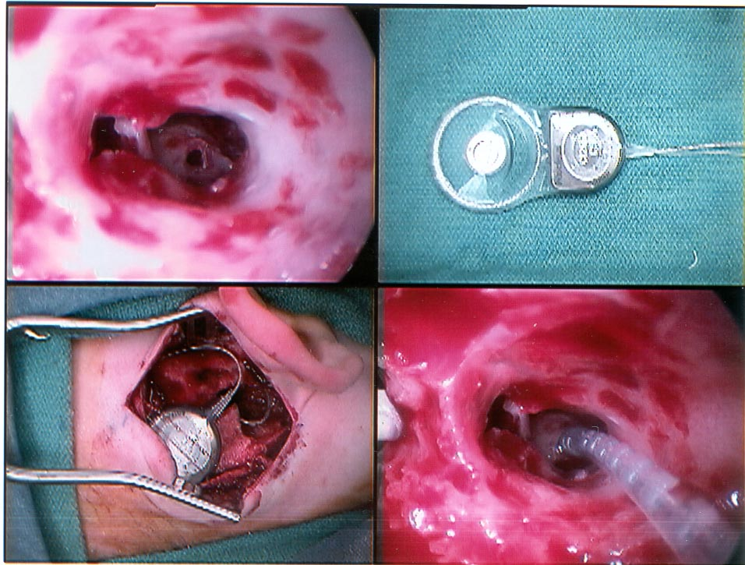
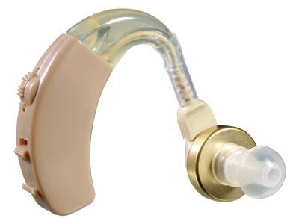
Deafness
Conduction Deafness
Nerve (sensorineural) Deafness
The hair cells in the cochlea get damaged.
Loud noises can cause this type of deafness.
NO WAY to replace the hairs.
Cochlea implant is possible.
Something goes wrong with the sound and the vibration on the way to the cochlea.
You can replace the bones or get a hearing aid to help.

Slide 19
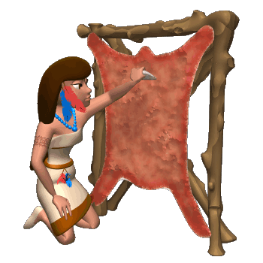
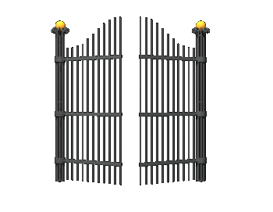
Touch
Receptors located in our skin.
Gate Control Theory of Pain

Slide 20
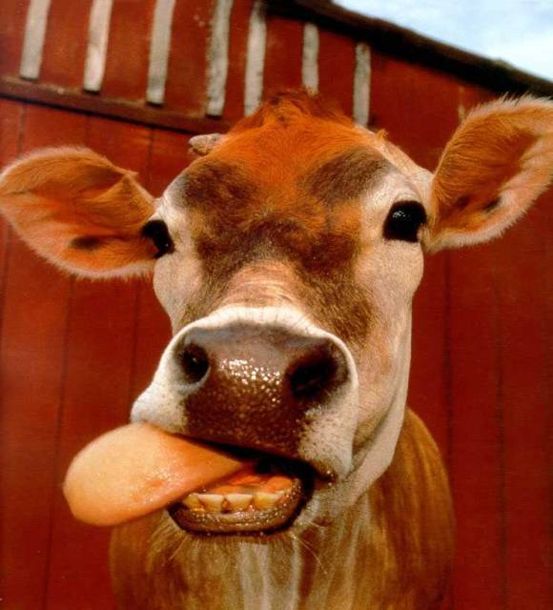
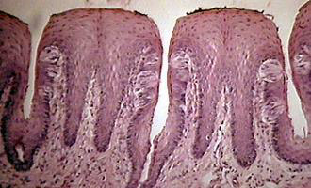
Taste
We have bumps on our tongue called papillae.
Taste buds are located on the papillae (they are actually all over the mouth).
Sweet, salty, sour and bitter.

Slide 21
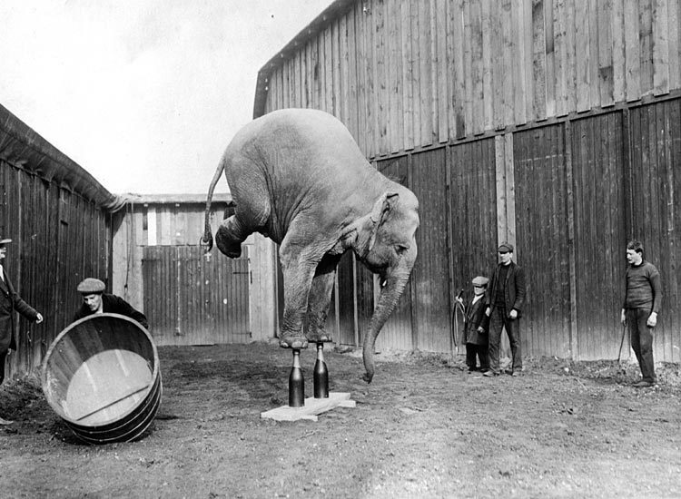
Vestibular Sense
Tells us where our body is oriented in space.
Our sense of balance.
Located in our semicircular canals in our ears.

Slide 22
Kinesthetic Sense
Tells us where our body parts are.
Receptors located in our muscles and joints.
Without the kinesthetic sense you couldn’t touch the button to make copies of your buttocks.

Slide 23
Measuring Senses
Absolute threshold.
Difference threshold.
Signal-detection theory.

Slide 24
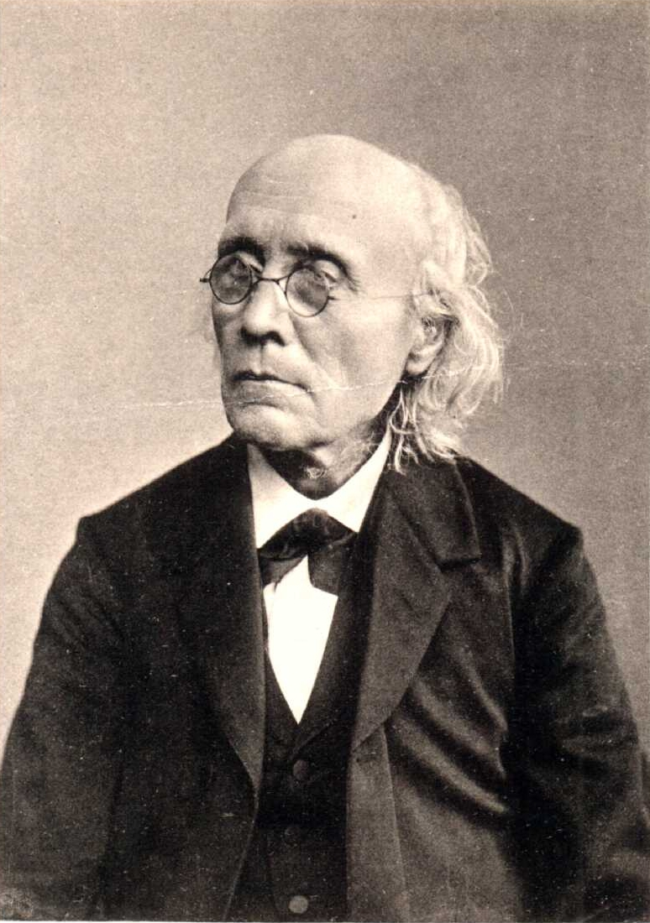
Gustav Fechner Pioneer in Psychophysics
1801-1887 (U. of Leipzig)
Theory: consciousness and matter coexist
Mind / body: two aspects of fundamental unity
Stared at sun! Afterimage of blue and yellow
Mathematical relationship b/n force of stimuli and intensity of sensation

Slide 25
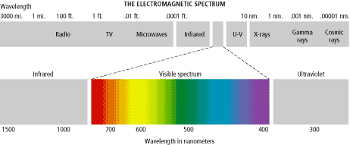
Absolute Threshold
The smallest quantity of physical energy that can be reliably detected by an observer.

Slide 26
Absolute Sensory Thresholds
Vision:
A single candle flame from 30 miles on a dark, clear night
Hearing:
The tick of a watch from 20 feet in total quiet
Smell:
1 drop of perfume in a 6-room apartment
Touch:
The wing of a bee on your cheek, dropped from 1 cm
Taste:
1 tsp. Sugar in 2 gal. water

Slide 27
Absolute threshold
“An absolute threshold is not absolute…”
What factors might affect the absolute threshold?
Repetition
Fatigue
Competing stimuli
Expectation

Slide 28
Difference Threshold
The smallest difference in stimulation that can be reliably detected by an observer when two stimuli are compared;
Also called Just Noticeable Difference (JND).

Slide 29
Sensation- Thresholds
Weber’s Law- change needed to detect a JND stays at constant proportion based on original intensity of the stimulus
light intensity- 8%
weight- 2%
tone frequency- 0.3%
For example, if JND for hearing is 5%, then:
100-decibel tone would have to increase to 105 decibels to detect a difference
Notes:
Try the following experiment: two envelopes, one with two quarters in it, the subject will be able to tell the difference, but then put the envelopes in a pair of shoes and try to tell the difference
Weber's Principle: difference thresholds grow with the magnitude of the stimulus
If you make $5 p/h a 25 cent hour raise will be noticeable but at $10 p/h you may need 50 cents.
If you are in sales, three piece suit and sweater, sell the suit first because after the suit the man will be more likely to buy
In car sales, after the sale customer won’t really notice $500 stereo
ADAPTation—habituation
After drinking tea with lemon, a grapefruit will not taste as sour
…but after a roll, it will taste especially sour
After holding salty water in mouth, it will taste less salty, and drinking fresh water afterwards, it will taste sweet

Slide 30
Weber’s Law
As a salesman, how might one use Weber’s law to increase chances of selling the following to one customer?
Built in ipod accessory: $100
New Truck: $25,000
Navigation system: $200
Sliding rear window: $125

Slide 31
Sensation- Thresholds
Signal Detection Theory
predicts how and when we detect a stimulus (signal) in the presence of competing stimuli (noise, objects etc.)
assumes that there is no single absolute threshold
Factors influencing detection (response criteria)
experience
expectations
motivation
level of fatigue
distractions

Slide 32
Signal-Detection Theory
A psychophysical theory that divides the detection of a sensory signal into a sensory process and a decision process.
 | Stimulus is Present | Stimulus is Absent
Response: “Present” | Hit | False Alarm
Response: “Absent” | Miss | Correct Rejection

Slide 33
SDT: Now You Try…
Is that car up ahead on the road way a police car?
Should a student be accepted into a graduate program?
 | Stimulus is Present | Stimulus is Absent
Response: “Present” | Hit | False Alarm
Response: “Absent” | Miss | Correct Rejection

