Slide 1
Abnormal Psychological Disorders
Mood & Personality Disorders

Slide 2
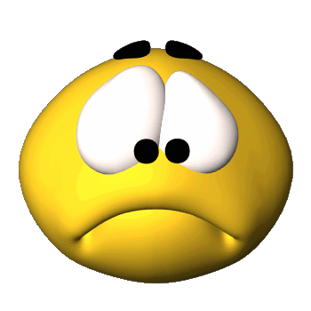
Mood Disorders
Experience extreme or inappropriate emotion.

Slide 3
Mood Disorders
Major depressive Disorder
At least 2 weeks feeling depressed, sad, etc
Reduced ability to function with others
Bereavement does not currently count
Problems with eating, sleeping, thinking, concentrating, decision making. Lack of energy. Suicidal thoughts, feeling worthless or guilty

Slide 4
Major Depression
A.K.A. unipolar depression
Unhappy for at least two weeks with no apparent cause.
Depression is the common cold of psychological disorders.

Slide 5
Mood Disorders
Bipolar Disorder (Cobb)
Manic phase – elation, distractibility, racing thoughts, exaggerated self-esteem
Depressive phase
Varying forms
Seasonal Affective Disorder
EX. Depression during winter

Slide 6
Bipolar Disorder
Formally manic depression.
Involves periods of depression and manic episodes.
Manic episodes involve feelings of high energy (but they tend to differ a lot…some get confident and some get irritable).
Engage in risky behavior during the manic episode.

Slide 7
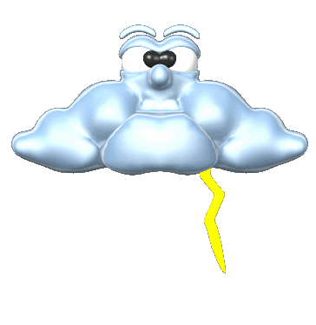
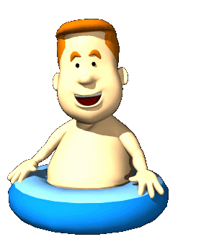
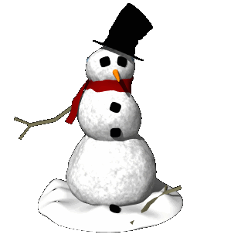
Seasonal Affective Disorder
Experience depression during the winter months.
Based not on temperature, but on amount of sunlight.
Treated with light therapy.

Slide 8
Suicide
More than 30,000 Americans per year
Women attempt suicide more
Men successfully complete suicide more
Most people that threaten suicide ARE serious
Upwards of 70% of people who commit suicide threatened to do so within three months preceding the suicide

Slide 9
Personality Disorders
Maladaptive or inflexible ways of dealing with others and one’s environment
Antisocial Personality Disorder (Natural Born Killers, No Country For Old Men)
Disregard for and violating rights of others without remorse
Often intelligent, entertaining, and or able to fake emotions
Borderline Personality Disorder (Girl, Interrupted)
Unstable emotions, fear of abandonment, inappropriate anger, feelings of worthlessness, impulsive, self-injury

Slide 10
Antisocial Personality Disorder
Lack of empathy.
Little regard for other’s feelings.
View the world as hostile and look out for themselves.

Slide 11
Dependent Personality Disorder
Rely too much on the attention and help of others.

Slide 12
Histrionic Personality Disorder
Needs to be the center of attention.
Whether acting silly or dressing provocatively.

Slide 13
Narcissistic Personality Disorder
Having an unwarranted sense of self-importance.
Thinking that you are the center of the universe.

Slide 14
Obsessive –Compulsive Personality Disorder
Overly concerned with certain thoughts and performing certain behaviors.
Not as extreme as OCD anxiety.

