Slide 1
Abnormal Psychological Disorders
Treatments

Slide 3
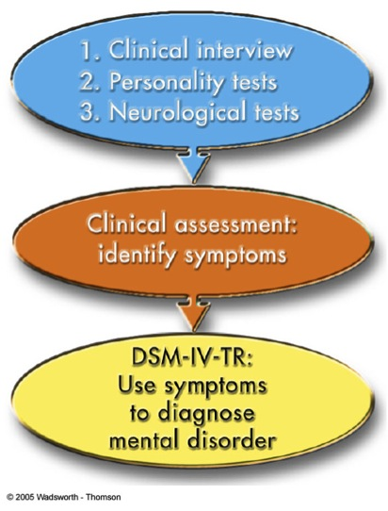
Psychotherapy
Treatment used by therapists to help trouble people overcome their problems
Verbal interaction between therapist and client
Development of a supportive and trusting relationship
Analysis by the therapist of the client’s problems
Help people understand and take ownership in solving problems
Can take on many forms

Slide 4
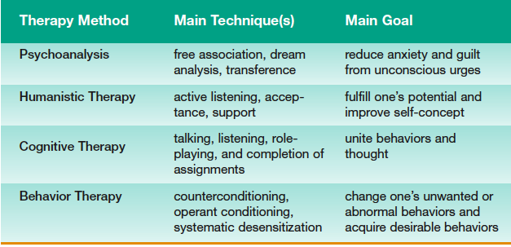

Slide 5
Group Therapy
Patients work together with the aid of a leader
Helps patients see how other people are struggling with similar problems
One therapist can help a large number at a reduced cost
Cognitive-Behavioral Therapy
Substituting healthy thoughts for negative ones
Changing disruptive behaviors for healthy ones

